Slide 1
PRAYER
11 KEY PRINCIPLES
Notes:
Principles = truths / realities of the Kingdom of God = ways of God
How to grow / increase the quality & power & effectiveness of your life of prayer
Things we’ve learned over the years that have made a significant difference in our prayer lives

Slide 2
Notes:
The Story Behind Passion of Christ Mel Gibson warned actor Jim Caviezel that playing the character of Christ was going to be very difficult and that if he accepted, he most likely would be marginalized by Hollywood.
Caviezel asked for a day to think about it and his response to Mel who was funding and directing the movie was: “I think we have to make it, even if it is difficult.” And something else, my initials are J.C., and I am 33 years old. “I didn’t realize that until now.”
Mel responded with “You’re really scaring me you know.”
During filming, Jim Caviezel who plays the part of Jesus lost 45 pounds, he was struck by lightning, he was accidentally struck twice during the scourging scene leaving a deep 14-inch scar, he dislocated his shoulder when the cross was dropped into the hole with him on the cross.
He then suffered pneumonia and hypothermia from being nearly naked with only a loin cloth on the cross for endless hours. The crucifixion scene alone took 5 weeks of the 2 months of shooting.
His body was so stressed and exhausted from playing the role that he had to undergo two open-heart surgeries after the filming production.
Jim explained, “I didn’t want people to see me. I just want them to see Jesus. Conversions will happen through that.”
Almost like a clairvoyant prediction, many amazing things happened.
Pedro Sarubbi, who played Barabbas, felt that it was not Caviezel who was looking at him, but Jesus Christ himself, as he played that role he said of Caviezel, “His eyes had no hatred or resentment towards me, only mercy and love.”
Luca Lionello, the artist who played Judas, was an avowed atheist before shooting began. He eventually converted and baptized his children.
One of the main technicians working on the film was a Muslim converted to Christianity.
Some producers said they saw actors dressed in white they didn’t recognize during one of the filming sessions, and when they reviewed the recordings they realized they couldn’t see them in that footage.
The Passion of the Christ is the highest-grossing US religious as well as the highest R-rated film of all time, with $370.8 million! Worldwide, it grossed $611 million. More importantly, it has reached 100’s of millions of people around the world. Mel Gibson paid $30 million out of his own pocket for the production of the film because no studio would take on the project.
Today Jim Caviezel simply and boldly proclaims his faith in Christ, and the miracle it was for him to represent Christ as an actor and a greater believer of Christ because of this experience.

Slide 3
PRAYER
11 KEY PRINCIPLES
#1
Just Pray
Notes:
More caught than taught!

Slide 4
PRAYER
11 KEY PRINCIPLES
#2
Majide
Notes:
Japanese word for “get real”
Be genuine / not flaky or hyper-religious
This is what our experience with Nick & Debby taught us
The question is: Who are we talking to?

Slide 5
PRAYER
11 KEY PRINCIPLES
#3
χαρά (khara)
Notes:
Don’t settle for anything less than a “I can’t wait to pray!”
Bill Johnson: “If you don’t like joy, you won’t like heaven!”

Slide 6
PRAYER
11 KEY PRINCIPLES
#4
Pray, Read, &
Meditate on Prayer
Notes:
Prayer Promise List

Slide 7
PRAYER
11 KEY PRINCIPLES
#5
2 Ears, 2 Eyes,
1 Mouth
Notes:
Deb’s teaching on Hearing God’s Voice

Slide 8
PRAYER
11 KEY PRINCIPLES
#6
Yes & Amen!
The Power of Agreement
Notes:
Corporate prayer

Slide 9
PRAYER
11 KEY PRINCIPLES
#7
PRAISE:
Praying from intimacy
Notes:
Talk re: friendship / love relationship / bridal paradigm
Prayer is not gritting your teeth but falling in love

Slide 10
PRAYER
11 KEY PRINCIPLES
#8
Don’t Forget
Your Sword

Slide 11
Notes:
Machairan = small sword or large knife

Slide 12
When we know the Word, we pray the Word,
and heaven echoes.
Lisa Bevere
International speaker, bestselling author & wife of John Bevere
Notes:
One of the top three life-changing truths:
Hearing
agreement
Scripture
Part of that is a natural outflowing of the anointing of the Word in and through our prayers
Another part is actually using the words of Scripture in our prayers
Another part is actually praying Biblical prayers: they carry a great weight of authority
Use NT Prayers
Give example of how I use Eph 3:14 on page 4

Slide 13
For this reason I kneel before the Father, from whom his whole family in heaven and on earth derives its name. I pray that out of his glorious riches he may strengthen you with power through his Spirit in your inner being,
Ephesians 3:14-16 (NIV)

Slide 14
When he looked out over the crowds, his heart broke. So confused and aimless they were,
like sheep with no shepherd.
“What a huge harvest!” he said to his disciples. “How few workers!
On your knees and pray for harvest hands!”
Matthew 9:36-38 (The Message)
Notes:
No prayer for finances

Slide 15
So now, Lord, listen to their threats to harm us. Empower us, as your servants, to speak the word of God freely and courageously. Stretch out your hand of power through us to heal, and to move in signs and wonders by the name of your holy Son, Jesus!” At that moment the earth shook beneath them, causing the building they were in to tremble. Each one of them was filled with the Holy Spirit, and they proclaimed the word of God with unrestrained boldness.
Acts 4:29-31 (Passion Translation)
Notes:
Follows story of man’s healing at Beautiful Gate
They were detained by the authorities, threatened with punishment and, under pressure, released
No prayer for protection
Praying Kingdom prayers

Slide 16
PRAYER
11 KEY PRINCIPLES
#9
Perseverance
Notes:
Pete Greig’s quote:
Keep it real
Keep it simple
Keep it up
Long-term praying: ask for new strategies / grit / faith

Slide 17
Keep on asking, and it will be given to you;
keep on seeking, and you will find;
keep on knocking,
and it will be opened unto you.
Matthew 7:7
Williams New Testament

Slide 18
For everyone who keeps on asking
will always receive,
and he who keeps on seeking
will always find,
and to him who keeps on knocking
it will always be opened.
Matthew 7:8
Williams New Testament
Notes:
Talk about the idea of “travail” (HANDOUT)
Intense prayer
24 hour prayer meetings

Slide 19
And another angel came and stood at the altar
with a golden censer, and he was given much incense
to offer with the prayers of all the saints on the
golden altar before the throne, and the smoke
of the incense, with the prayers of the saints,
rose before God from the hand of the angel.
Then the angel took the censer and filled it with fire
from the altar and threw it on the earth,
and there were peals of thunder, rumblings,
flashes of lightning, and an earthquake.
Revelation 8:3-5
English Standard Version
Notes:
Check out Daniel 10 & his 21 day fast. What happened in the invisible world during that time?
There are a LOT of things going on that we’re unaware of

Slide 20
We have no idea how busy God's hands are
even when His mouth seems closed.
Where God is concerned,
silence never equals slumber.
Beth Moore
Author & Bible teacher
Notes:
God is always at work
“…My Father is always at his work to this very day…” John 5:17
Waymaker song:
“Even when I can’t see it, You’re working
Even when I don’t feel You, You’re working”

Slide 21
God shapes the world by prayer.
Prayers are deathless.
The lips that uttered them may be closed in death,
the heart that felt them may have ceased to beat,
but the prayers live before God,
and God's heart is set on them.
E.M. Bounds
1835-1913
Methodist author of many classic books on the prayer life

Slide 22
Notes:
Story of Count Zinzendorf & the Moravians
1700 – 1760
Herrenhut
100 year non-stop prayer started in 1727
Wesleys & the Great Awakening

Slide 23
PRAYER
11 KEY PRINCIPLES
#10
Pray for
One Another

Slide 24
I urge you, brothers, by our Lord Jesus Christ
and by the love of the Spirit,
to join me in my struggle
by praying to God for me.
Romans 15:30
Notes:
This is the passage that we used o encourage you to have people praying for you during your time in DSM.

Slide 25
God…is my witness how constantly I remember you
in my prayers at all times…
Romans 1:9-10a
I have not stopped giving thanks for you,
remembering you in my prayers.
Ephesians 1:16
I thank God…as night and day
I constantly remember you in my prayers.
2 Timothy 1:3
I always thank my God as I remember you in my prayers,
Philemon 1:4
Notes:
More than 500x the Bible talks about remembering & not forgetting
MCI = mild cognitive impairment
The problem over the over stimulation of the media
My prayer list
The balance between a disciplined approach to prayer & being led by the Spirit
Both are equally important
Prayer lists – waiting on the Lord for specifics type of prayer – corporate prayer – prayer walks

Slide 26
PRAYER
11 KEY PRINCIPLES
#11
Pray for
the Lost

Slide 27
Only ask, and I will give you
the nations as your inheritance,
the whole earth as your possession.
Psalm 2:8
New Living Translation
Notes:
30 Days of Prayer for the Muslim World / Hindu world / nation / TN on Thursday

Slide 28
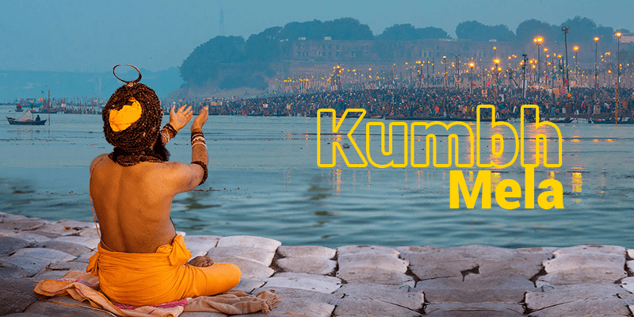
Notes:
More tha 200 million in 2019 / 50 million on “high day”

Slide 29
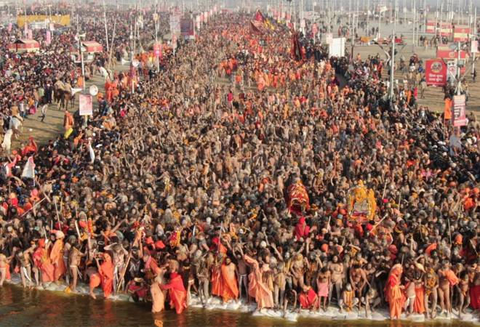

Slide 30
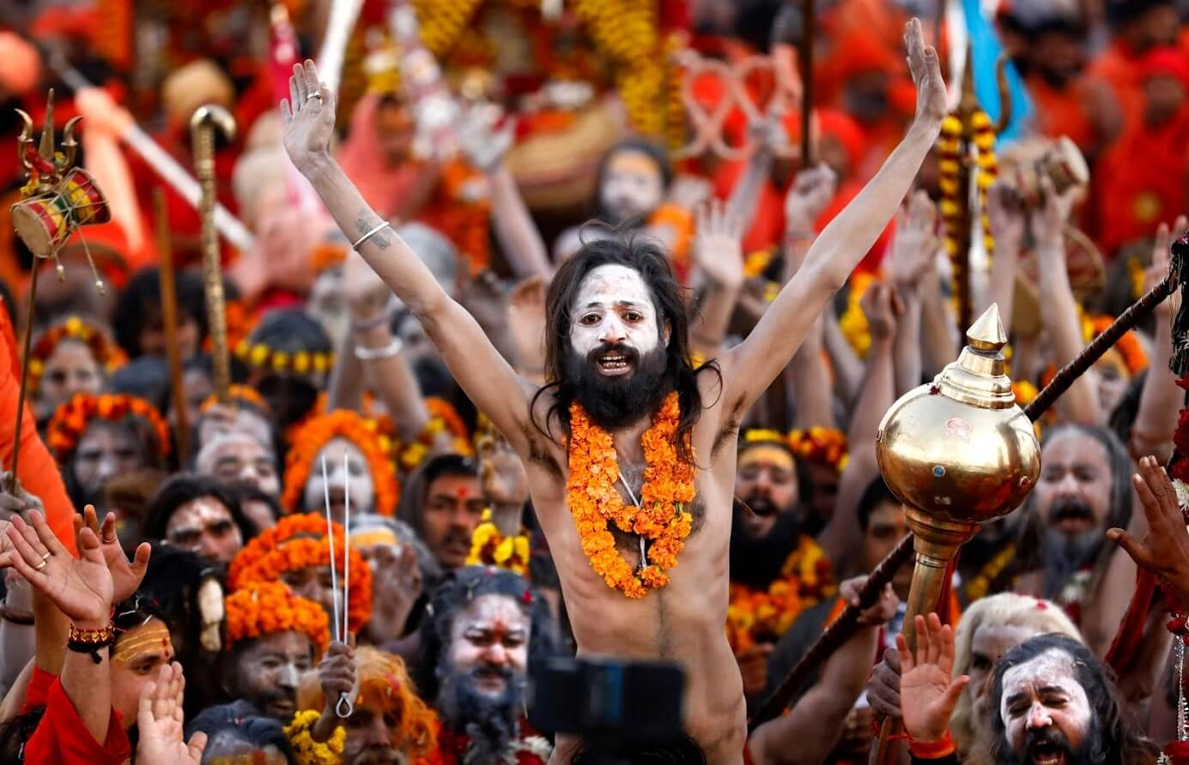

Slide 31
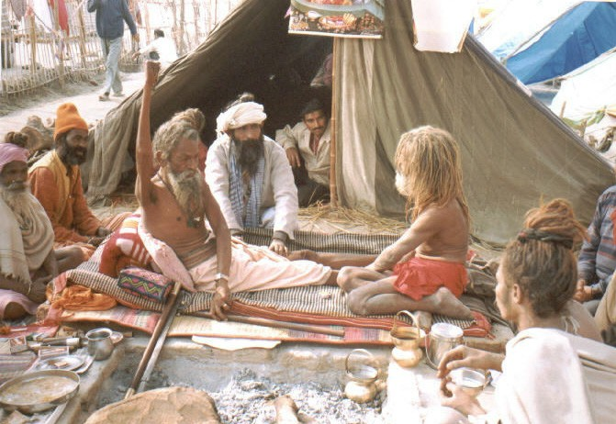
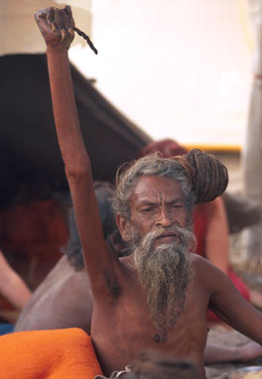
Notes:
Amar Bharati
Over 50 years

Slide 32
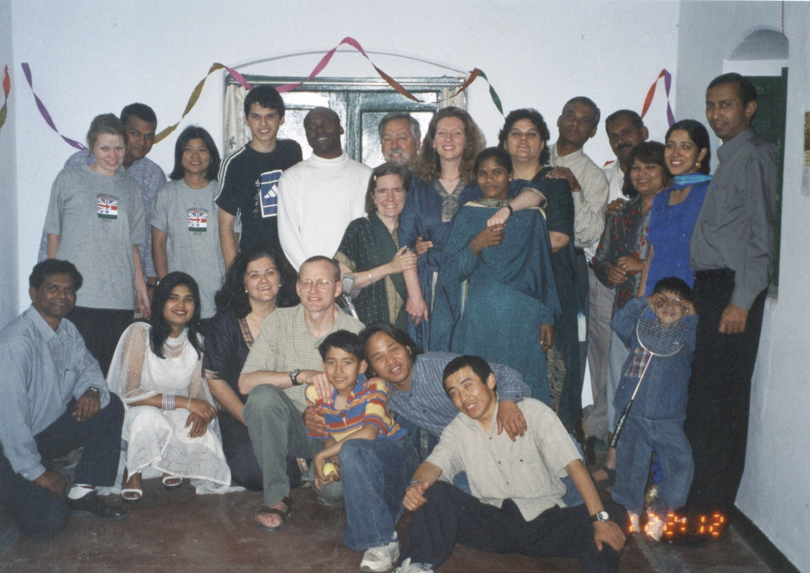

Slide 33
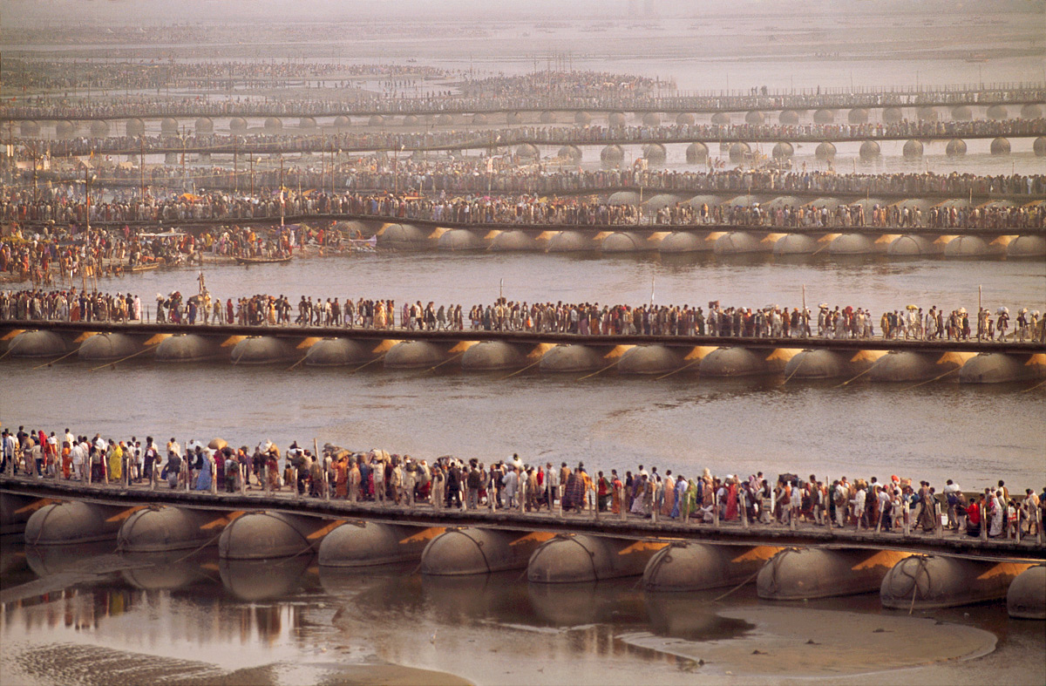

Slide 34
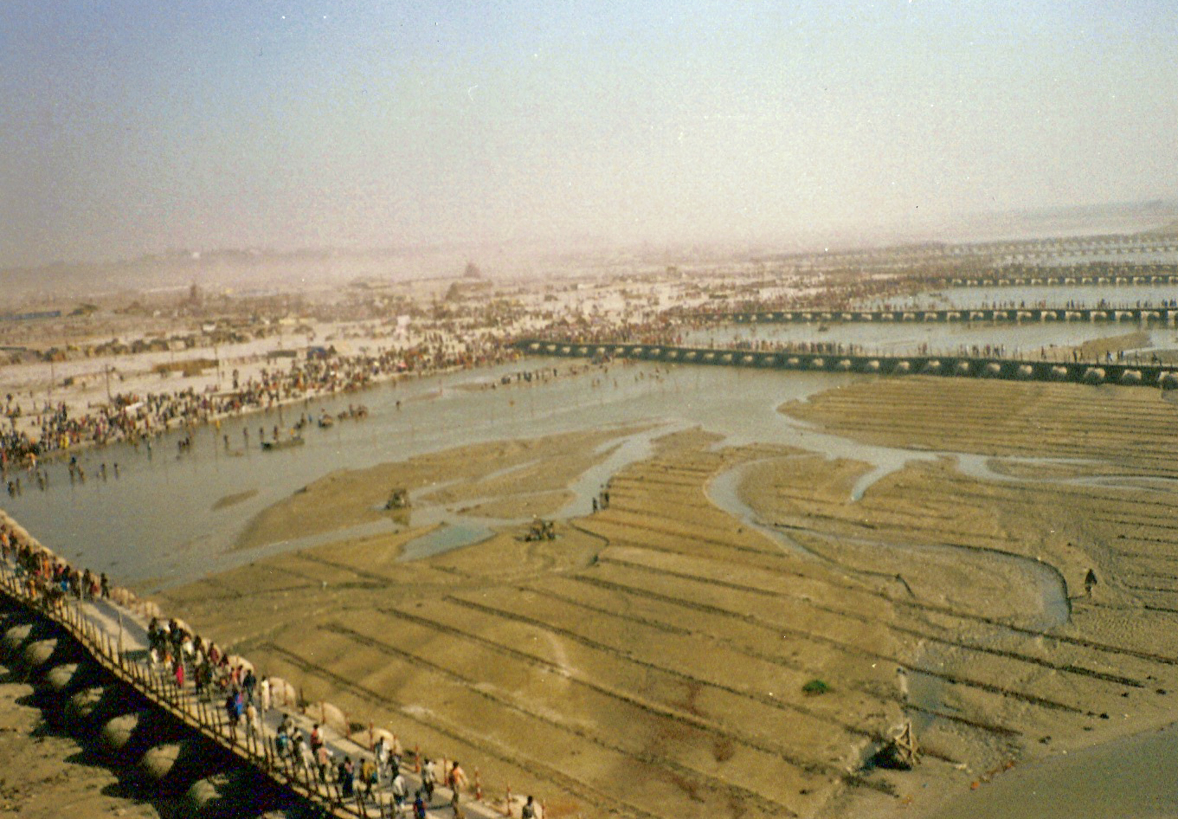

Slide 35
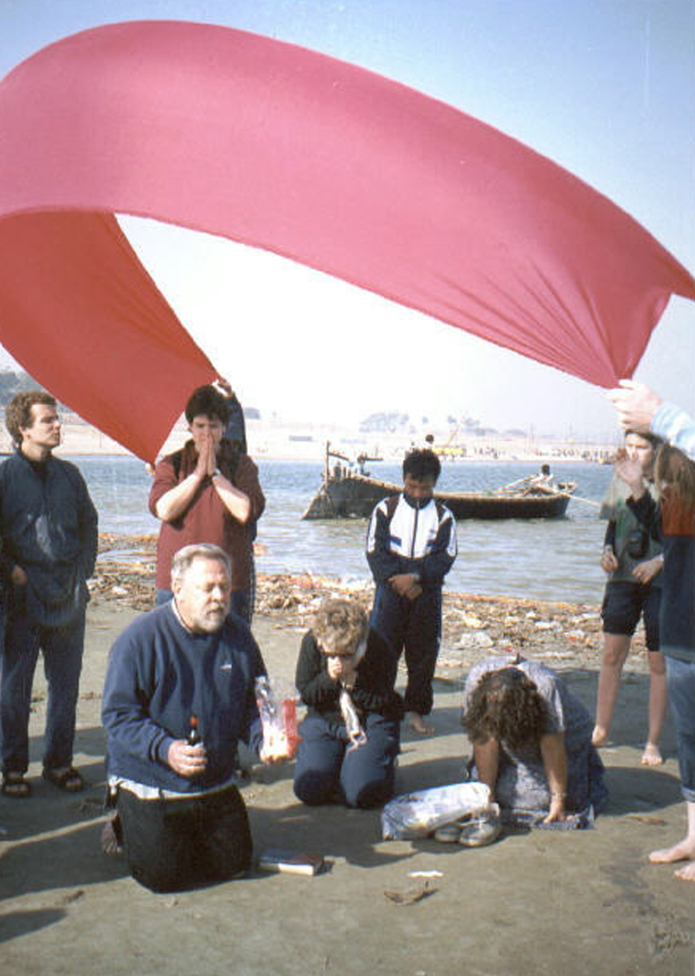

Slide 37
Brothers, my heart’s desire
and prayer to God for the Israelites
is that they may be saved.
Romans 10:1
Notes:
God highlighting the importance of Israel’s place in God’s plan for the world
Tony Sperandeo & our trip to Israel in May
SHOULD WE SHOW HISTORY MAKERS VIDEO? / Delirious: Live from London

Slide 38
History Makers
DELIRIOUS!
Is it true today that when people pray
Cloudless skies will break
Kings and queens will shake
Yes, it's true and I believe it
I'm living for you
Notes:
HISTORY MAKERS

Slide 39
Is it true today that when people pray
We'll see dead men rise
And the blind set free
Yes it's true and I believe it
I'm living for you
Notes:
HISTORY MAKERS

Slide 40
I'm gonna be a history maker in this land
I'm gonna be a speaker of truth to all mankind
I'm gonna stand, I'm gonna run
Into your arms, into your arms again
Into your arms, into your arms again
Notes:
HISTORY MAKERS

Slide 41
Well it's true today that when people stand
With the fire of God, and the truth in hand
We'll see miracles, we'll see angels sing
We'll see broken hearts making history
Yes it's true and I believe it
We're living for you
Notes:
HISTORY MAKERS

Slide 42
I'm gonna be a history maker in this land
I'm gonna be a speaker of truth to all mankind
I'm gonna stand, I'm gonna run
Into your arms, into your arms again
Into your arms, into your arms again
Notes:
HISTORY MAKERS

