Slide 1
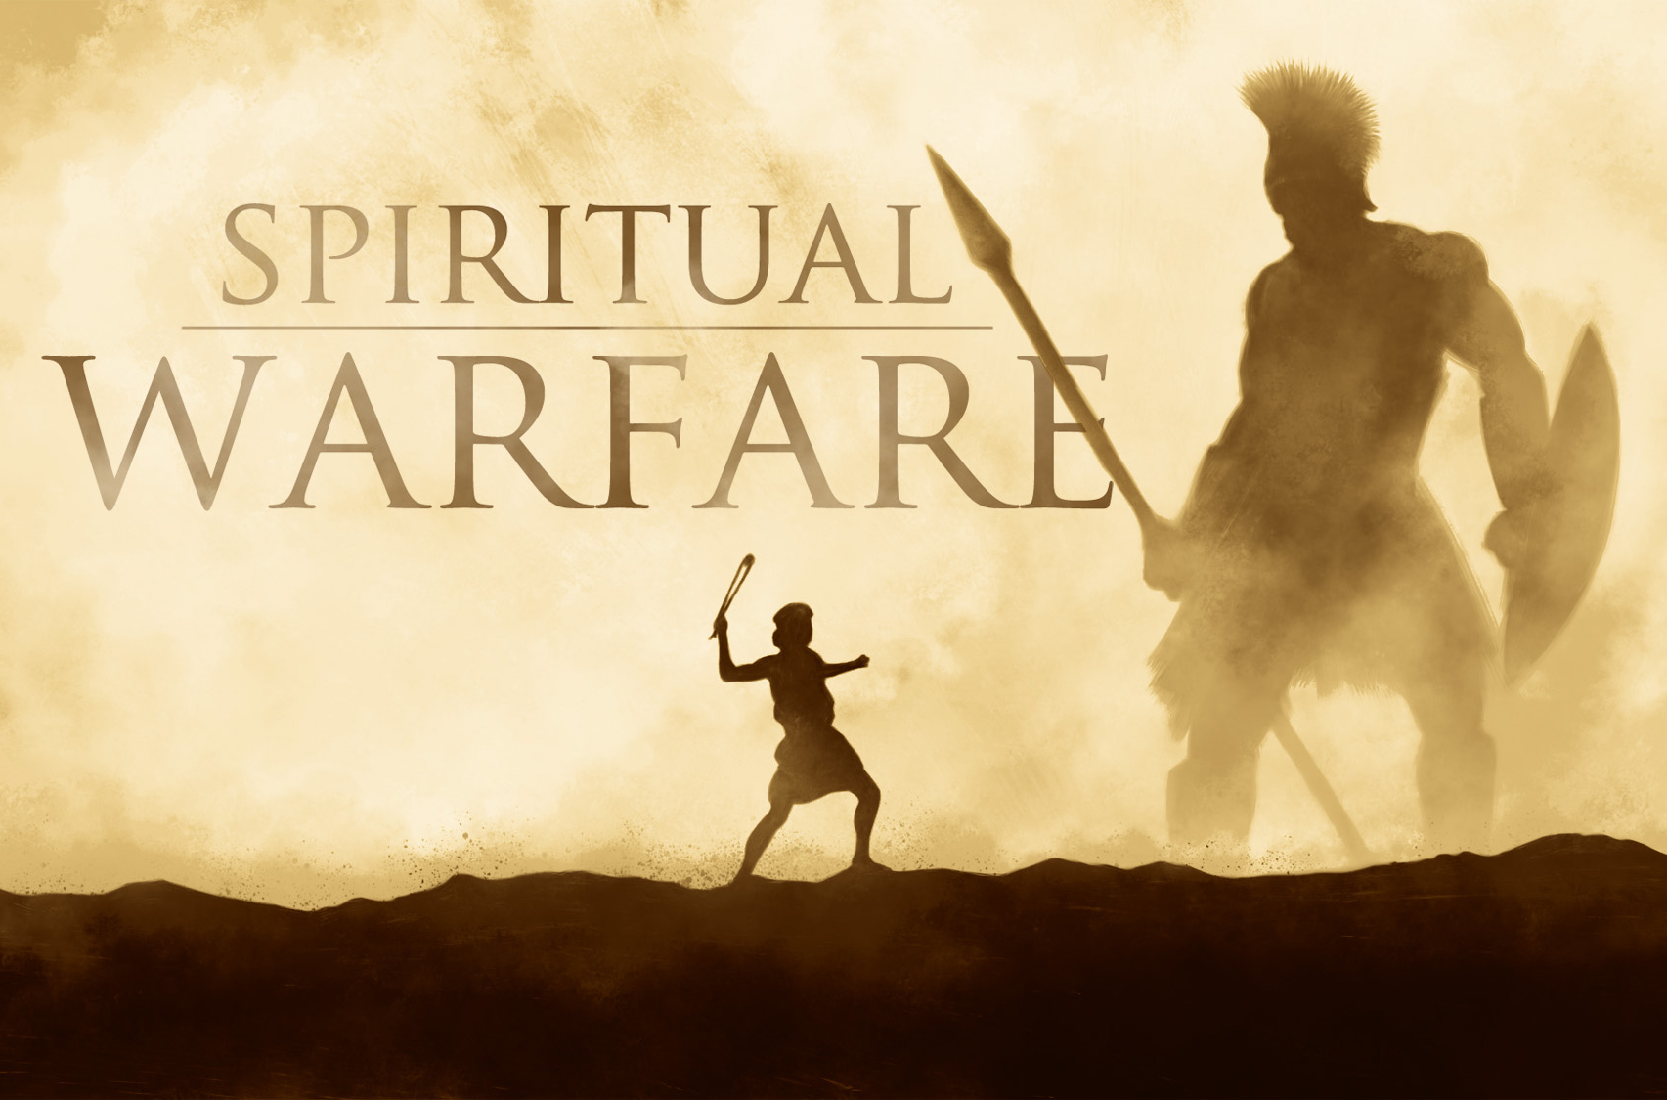
Notes:
Don’t forget sword / bows & arrows / books on SW ./ CELL PHONE TO CALL DEB
Tried to make it as simple & clear as possible
Open to questions
Tell about my journey in learning spiritual warfare / Idyllwild / India / SW study in OT
More than 3,000 texts on warfare just in the OT
We are born into a warzone! No choice about that.
How we see it, how aware we are, and what we do about it, how we respond, makes all the difference in the world between victory & defeat, freedom & bondage
Our choices DO make a difference

Slide 2
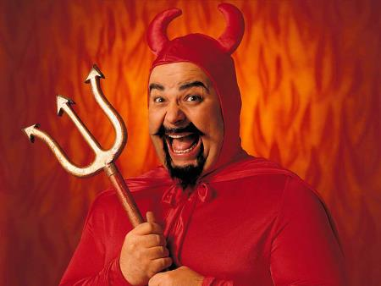
Spiritual Warfare is NOT a joke
Notes:
Nothing to laugh at
The consequences are SERIOUS and eternal

Slide 3
Spiritual Warfare is NOT just
Notes:
It’s a whole lifestyle
Also includes “the world” and “the flesh” and “death”

Slide 4
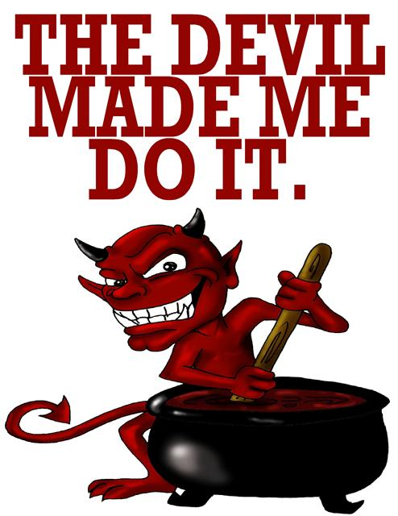
Spiritual Warfare is NOT saying
Notes:
He can’t MAKE anyone do evil, unless they’ve made a covenant or “sold their souls” to him; then He has the right
Neither is it our parent’s fault
or Adam’s fault
Nor a disease that I can’t help or be responsible for
We must take responsibility for our actions, attitudes & where our lives are at!!
It’s called “walking in the light” (1 John 1:9)

Slide 5
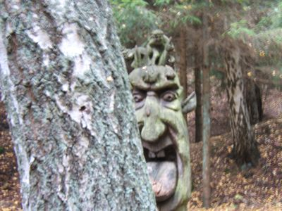
Spiritual Warfare is NOT finding a demon behind every tree or rock
Notes:
We need to fix our eyes on Jesus, not the Devil
They are not to compare!!
Although there are some in the Body of Christ who “see” more than others

Slide 6
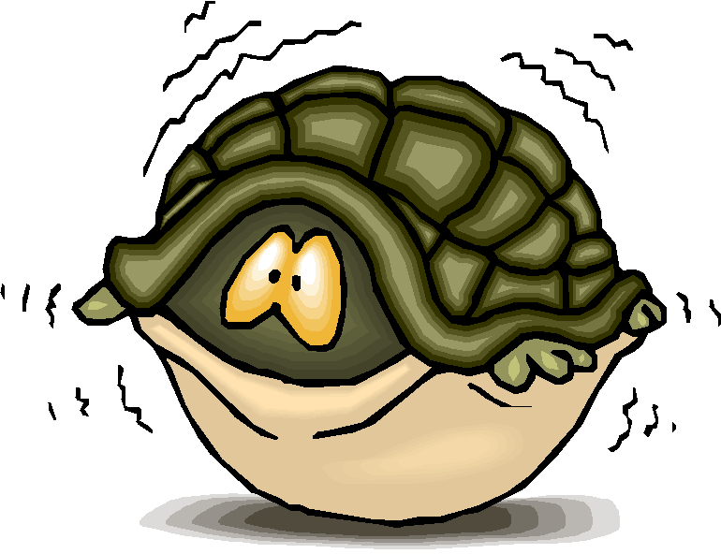
Spiritual Warfare is NOT to fear
Notes:
>300x “don’t fear”
Demons are not to be feared
People are not to be feared (fear of man)
God is to be feared

Slide 7
1. Become more aware of satan, but totally impressed with God 2. Learn God’s ways in warfare 3. Learn the enemy’s ways in warfare 4. Learn our authority in being seated in a place of victory 5. Grow from VICTIM to VICTOR to LIBERATOR
Our Goals
Notes:
HANDOUT

Slide 8
EPHESIANS 6:10-18
Notes:
Read out loud from 4 translations (WHITE HANDOUT):
King James
NIV
NLT
Passion
LET’S TAKE SOME TIME TO PUT ON THE ARMOR

Slide 9
1. What does this piece of armor represent? 2. What does it protect defensively? 3. What does it enable you to do offensively? 4. Why is this important in spiritual warfare?
Putting on the Armor
Notes:
LET’S PUT ON THE ARMOR
Divide staff & students into 6 groups (BLUE HANDOUT)
take 7 minutes
What does this piece of armor represent?
What does it protect defensively?
What does it enable you to do offensively?
Why is this important in spiritual warfare?
Belt of truth = Debby, Nathanael, Roni, Lindsey
Breastplate of righteousness = Mark, James, Nona,
Shoes of Gospel of Peace = Tracy, Tyler, Deb Poag, Rachel
Shield of faith = Kimberley, Roy, Karen
Helmet of salvation = Kim Emberton, Dale, Gretchen
Sword of the Spirit = Teresa, Willow, Nicole

Slide 11
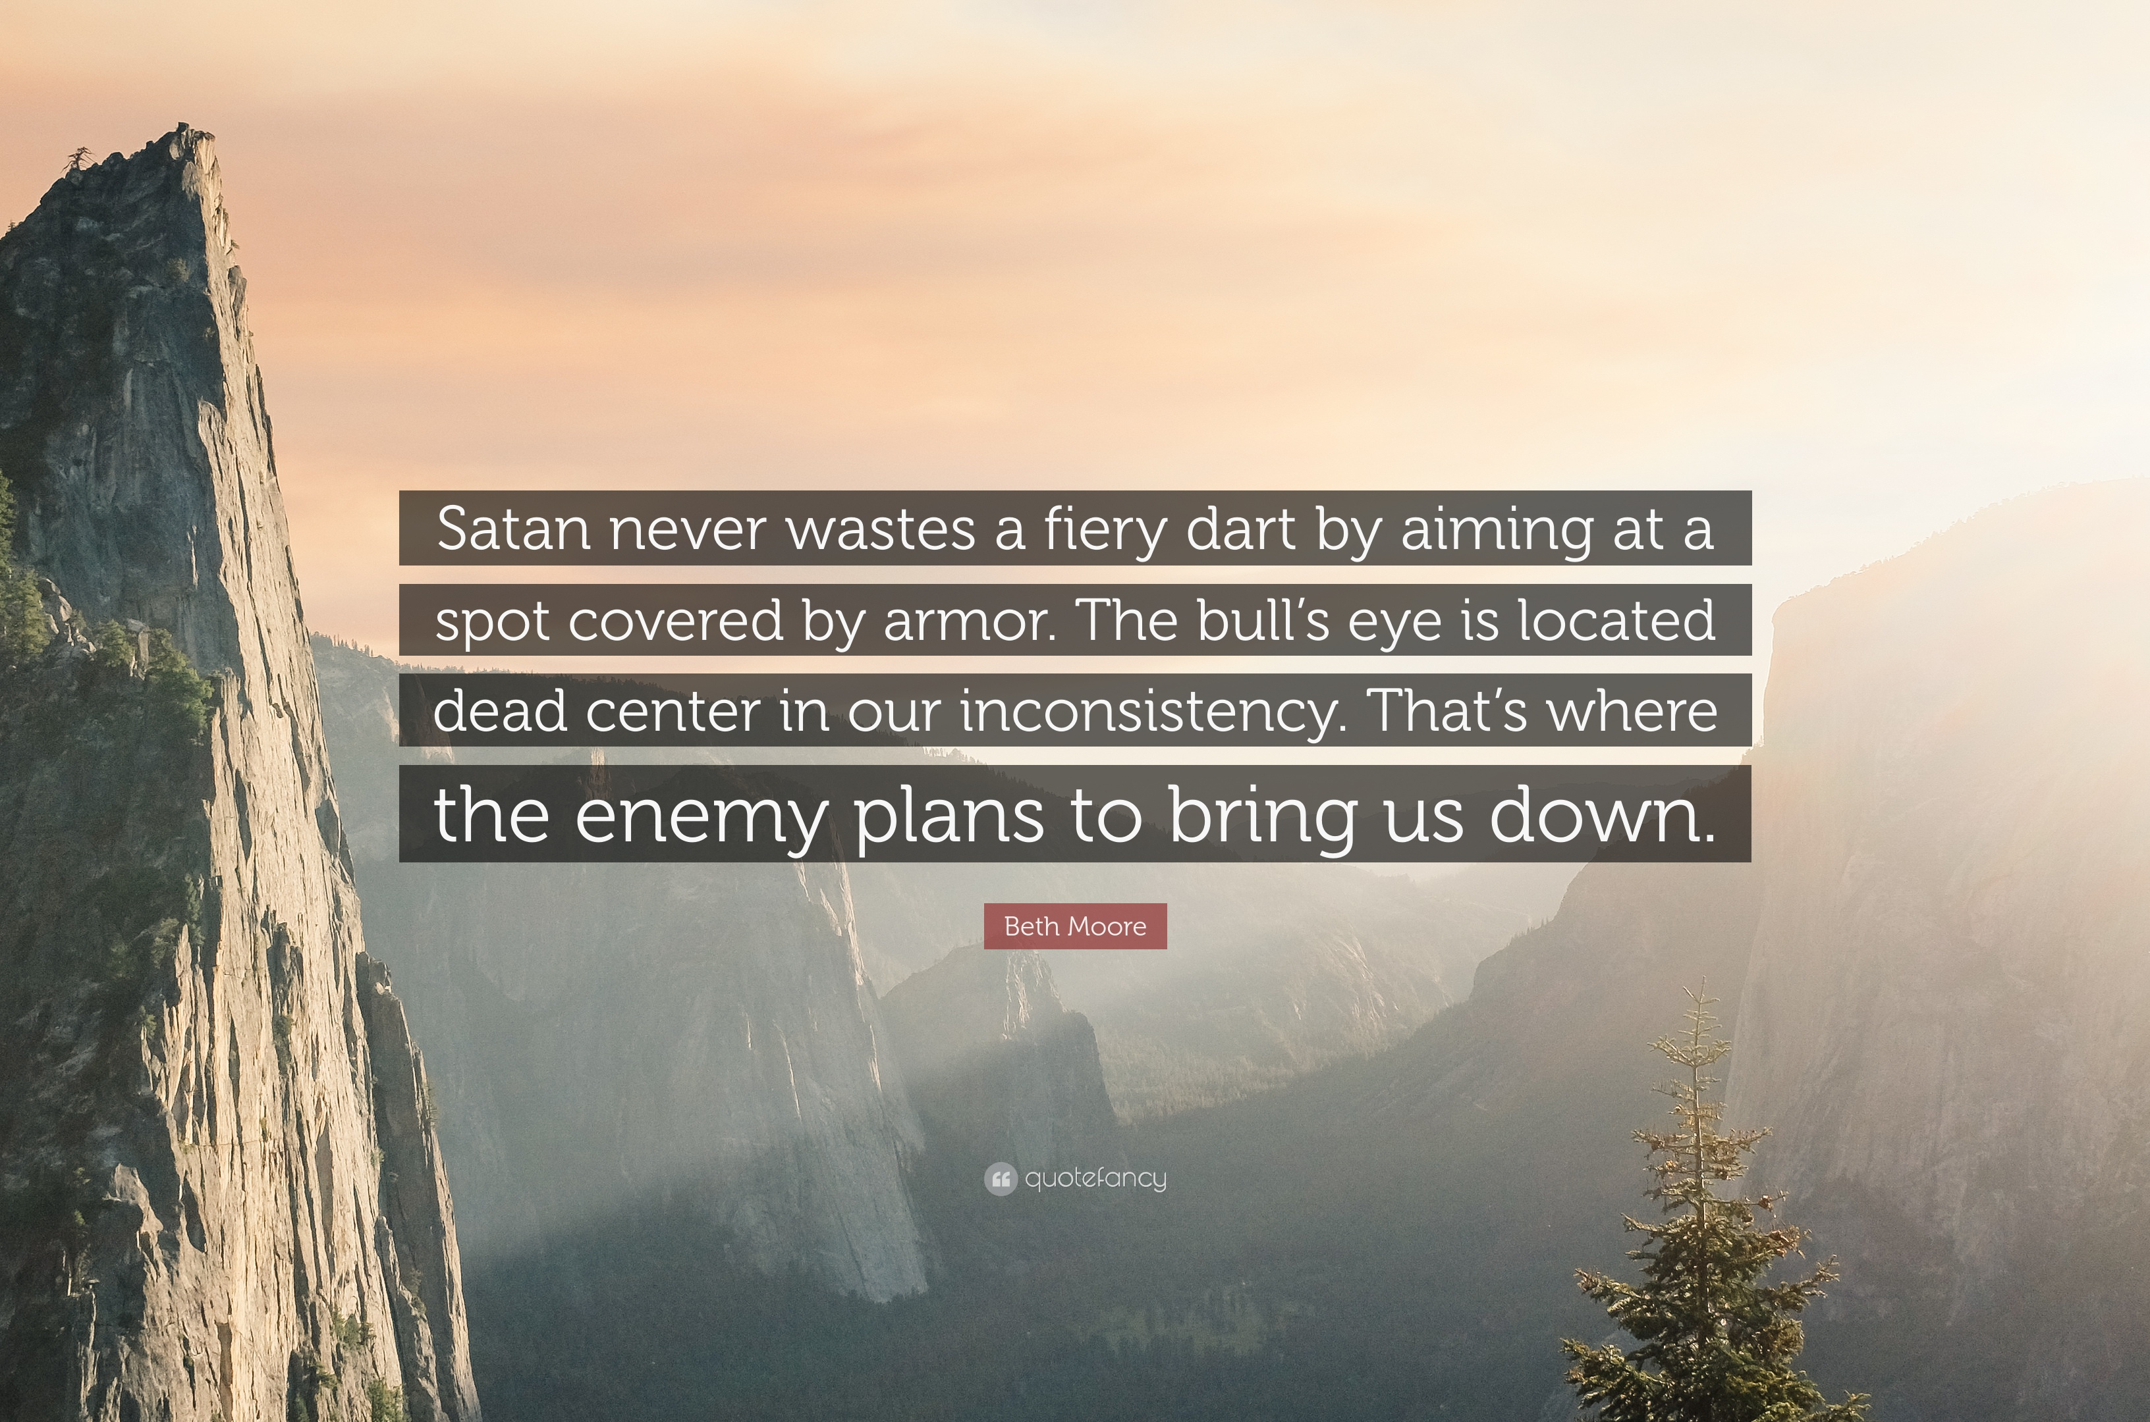

Slide 12
7 Key Principles of Spiritual Warfare #1 IT’S VERY REAL BUT INVISIBLE
Notes:
Learning God’s Kingdom ways in warfare

Slide 13
And we don’t focus our attention
on what is seen but on what is unseen,
for what is seen is temporary,
but the unseen realm is eternal.
2 CORINTHIANS 4:18 (TPT)
Notes:
Even in the physical realm, MANY things are invisible
The human body (scale of the universe)
Give example of “wireless phones” in the physical realm / call Debby
Radio waves
Microwaves
Ultraviolet
Infrared
X-rays
Gamma rays
Jay’s teaching on “seeing”
Need to be FULLY convinced of the reality of this dimension of reality

Slide 14
Notes:
Just because we don’t see it doesn’t mean it’s not there

Slide 15
2 KINGS 6:8-17
Notes:
Joram (Jehoram) is the very bad King of Israel (2,900 years ago) / reigned 11 years / son of Ahab & Jezebel
BenHadad is King of Syria (Aram) / “son of a local deity”
See things as they are (“open his eyes”)

Slide 16
DANIEL 10
Notes:
Cyrus (Ezra 1)

Slide 17
7 Key Principles of Spiritual Warfare #2 GOD IS A WARRIOR
Notes:
Don’t need to get into this too much tonight as Roy, Dale & James will be speaking on this June 6th

Slide 18
The LORD is a warrior;
Yahweh is his name!
EXODUS 15:3 (NLT)
Notes:
Just following the Exodus from Egypt 3300 years ago
Day after Passover: 15th Nissan

Slide 19
So wake up, you living gateways!
Lift up your heads, you ageless doors of destiny!
Welcome the King of Glory,
for he is about to come through you.
You ask, “Who is this Glory-King?”
The Lord, armed and ready for battle,
the Mighty One, invincible in every way!
PSALM 24:7-8 (TPT)

Slide 20
So wake up, you living gateways, and rejoice!
Fling wide, you ageless doors of destiny!
Here he comes; the King of Glory is ready to come in.
You ask, “Who is this King of Glory?”
He’s the Lord of Victory, armed and ready for battle,
the Mighty One, the invincible Commander of
heaven’s hosts! Yes, he is the King of Glory!
PSALM 24:9-10 (TPT)

Slide 21
צְבָא֑וֹת יְהוִה
YHVH Tsabaoth
Notes:
This is the name “Lord of Hosts” in NKJV
Sabaoth = hosts / armies

Slide 22
The LORD will march forth like a mighty hero;
he will come out like a warrior, full of fury.
He will shout his battle cry
and crush all his enemies.
ISAIAH 42:13 (NLT)

Slide 23
WHY?
Notes:
We live in a VERY fallen world, full of sin and under the devil’s influence
Live a cheerful life, without complaining or division among yourselves.
For then you will be seen as innocent, faultless, and pure children of God, even though you live in the midst of a brutal and perverse culture.
For you will appear among them as shining lights in the universe, offering them the words of eternal life.
Philippians 2:14-16 (TPT)
We know that we are children of God and that the world around us is under the control of the evil one.
1 John 5:19 (NLT)
Sin, rebellion, pride, violence, wars, perversions
Ezekiel 28
Isaiah 14
Genesis 3
God is eternally holy
He has enemies!!!
He hates sin because He knows what it does to us and this world
He’s fighting on our behalf!!!

Slide 24
7 Key Principles of Spiritual Warfare #3 THE BRIDE IS A WARRIOR
Notes:
It’s an honor & calling
It’s a part of who we are as God’s people
Warfare & intimacy go hand-in-hand
Nothing more intimate than a bride
Both men & women!

Slide 25
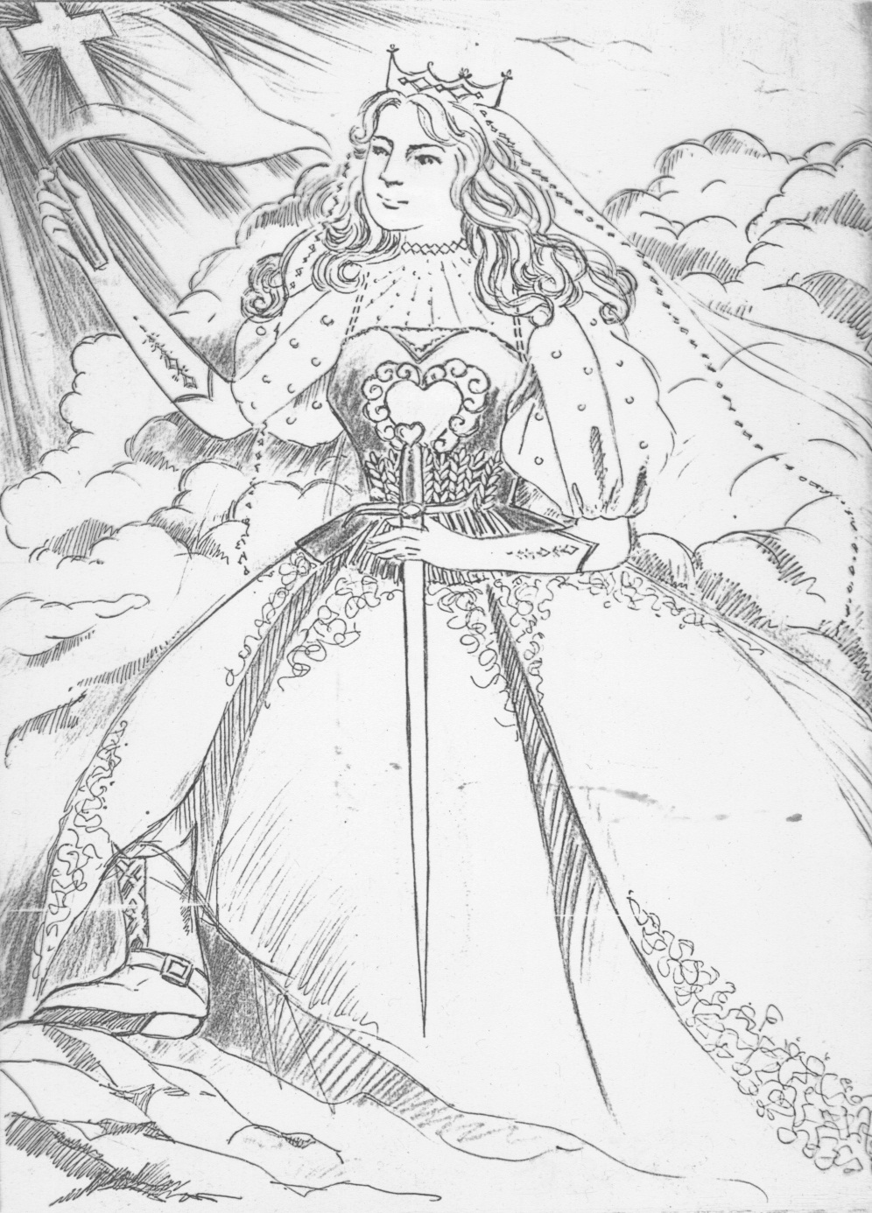
The Warrior Bride

Slide 26
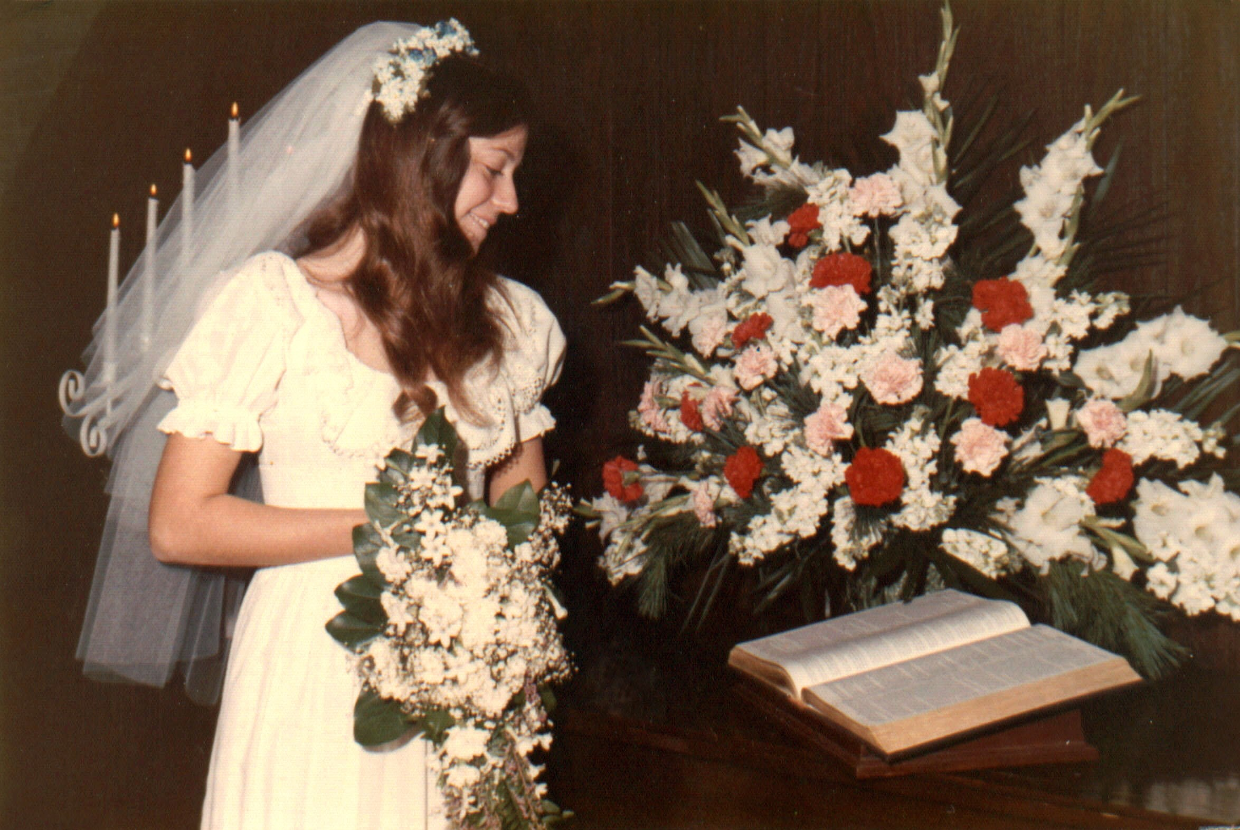
The Warrior Bride

Slide 27
REVELATION 19:6-16
Notes:
Then I heard what sounded like a great multitude, like the roar of rushing waters and like loud peals of thunder, shouting: “Hallelujah! For our Lord God Almighty reigns.
Let us rejoice and be glad and give him glory! For the wedding of the Lamb has come, and his bride has made herself ready.
Fine linen, bright and clean, was given her to wear.” (Fine linen stands for the righteous acts of the saints.)
Then the angel said to me, “Write: ‘Blessed are those who are invited to the wedding supper of the Lamb!’ ”
And he added, “These are the true words of God.” At this I fell at his feet to worship him.
But he said to me, “Do not do it! I am a fellow servant with you and with your brothers who hold to the testimony of Jesus.
Worship God! For the testimony of Jesus is the spirit of prophecy.”
I saw heaven standing open and there before me was a white horse, whose rider is called Faithful and True.
With justice he judges and makes war. His eyes are like blazing fire, and on his head are many crowns.
He has a name written on him that no one knows but he himself. He is dressed in a robe dipped in blood, and his name is the Word of God.
The armies of heaven were following him, riding on white horses and dressed in fine linen, white and clean.
Out of his mouth comes a sharp sword with which to strike down the nations. “He will rule them with an iron scepter.”
He treads the winepress of the fury of the wrath of God Almighty. On his robe and on his thigh he has this name written:
KING OF KINGS AND LORD OF LORDS.
REVELATION 19:6-16

Slide 28
7 Key Principles of Spiritual Warfare #4 WE HAVE BEEN GIVEN AUTHORITY

Slide 29
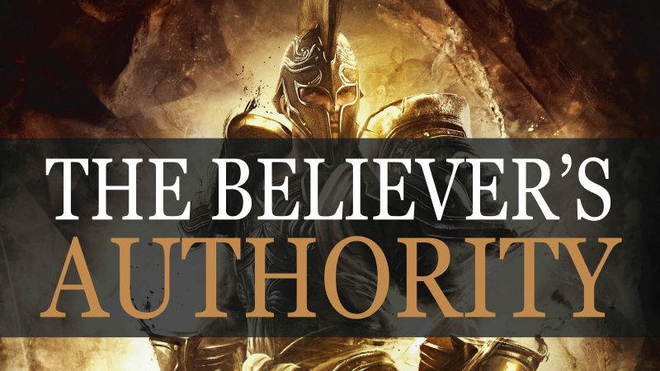
Notes:
Authority is a big deal
Without it, you can accomplish nothing
You can have all the power in the world available to you. But without the authority to use it, it will sit there unused.

Slide 30
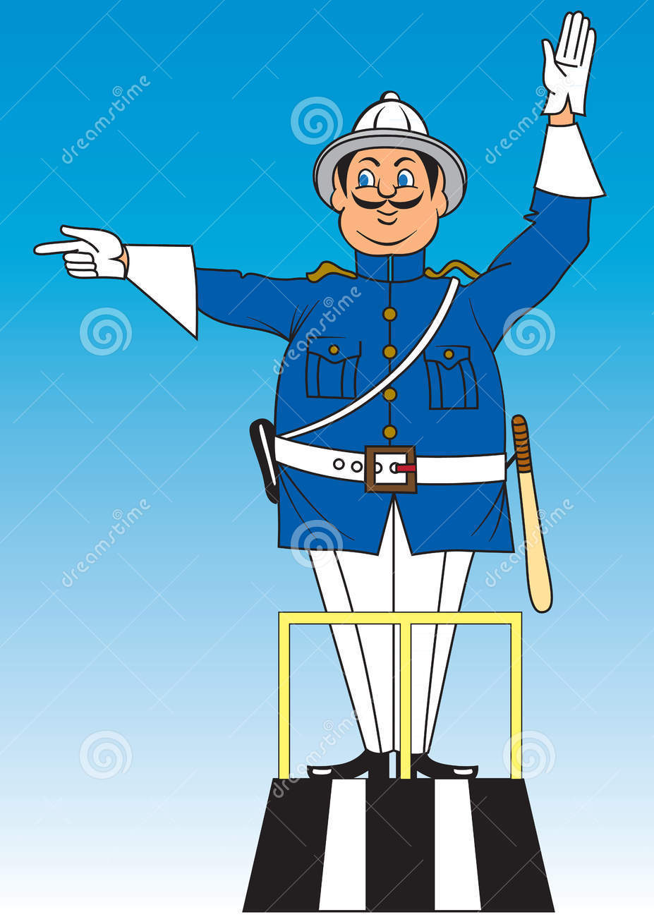
Notes:
Tell story re: Mexican traffic policeman with white glove
Mexico City = 22 million
New Delhi = 32 million
Tennessee = 7 million
Knoxville = 771,000

Slide 31
MATTHEW 16:13-19;
MARK 8:27-30; LUKE 9:18-21
Notes:
Read from BEIGE handout
Soon after, Jesus left Galilee and headed north toward the villages near Caesarea Philippi.
At one point on the way, when He was alone praying with His disciples nearby,
He turned toward them and asked, “Who are people saying that I, the Son of Man, am?”
“Some say You’re John the Baptist,” they answered.
“Others say You’re Elijah, while some others say You’re Jeremiah or one of the other prophets reincarnated.”
“But what about you?” Jesus asked. “Who do you say that I am?”
Simon Peter spoke up and said, “You are the Messiah, the Son of the living God.”
Jesus responded, “You’re a blessed man, Simon Bar-Jonah! For no person has revealed this to you,
but My Father who is in heaven, He has supernaturally revealed this to you.
And I’m also telling you, that you are Peter, and on this rock I’ll build My church, and even the gates of hades shall not be able to conquer it.
Moreover, I’ll give you the keys of the kingdom of heaven, and whatever you bind on earth shall already be bound in heaven,
and whatever you release on earth shall already be released in heaven.”
MATTHEW 16:13-19; MARK 8:27-30; LUKE 9:18-21
Keys of kingdom / binding & loosing
Lord’s Prayer = “Your Kingdom come on earth as it is in heaven”

Slide 32
Soon after, Jesus left Galilee and headed north toward the villages near Caesarea Philippi. At one point on the way, when He was alone praying with His disciples nearby, He turned toward them and asked,
“Who are people saying that I, the Son of Man, am?”
“Some say You’re John the Baptist,” they answered.
“Others say You’re Elijah, while some others say You’re Jeremiah or one of the other prophets reincarnated.”

Slide 33
“But what about you?” Jesus asked.
“Who do you say that I am?”
Simon Peter spoke up and said,
“You are the Messiah, the Son of the living God.”
Jesus responded, “You’re a blessed man, Simon Bar-Jonah! For no person has revealed this to you,
but My Father who is in heaven,
He has supernaturally revealed this to you.

Slide 34
And I’m also telling you, that you are Peter, and on this rock I’ll build My church, and even the gates of hades shall not be able to conquer it. Moreover,
I’ll give you the keys of the kingdom of heaven,
and whatever you bind on earth shall already
be bound in heaven, and whatever you release
on earth shall already be released in heaven.”

Slide 35
Then Jesus came close to them and said,
“All the authority of the universe has been given to me.
Now go in my authority and make disciples of all nations, baptizing them in the name of the Father, the Son, and the Holy Spirit. And teach them to faithfully follow all that I have commanded you. And never forget that I am with you every day, even to the completion of this age.”
MATTHEW 28:18-20 (TPT)

Slide 36
Later on, the seventy-two returned with joy, saying,
“Lord, even the demons are subject to us in Your name!”
So, Jesus said to them, “I watched Satan fall from heaven like a flash of lightning. And listen, I have given you the authority to trample upon serpents and scorpions, and over all the power of the enemy, and nothing shall hurt you. Nevertheless, don't rejoice that the spirits are subject to you,
but rejoice that your names are written in heaven.”
LUKE 10:17-20

Slide 37
This is the mighty power that was released when God raised Christ from the dead and exalted him to the place of highest honor and supreme authority in the heavenly realm! And now he is exalted as first above every ruler, authority, government, and realm of power in existence! He is gloriously enthroned over every name that is ever praised, not only in this age, but in the age that is coming!
EPHESIANS 1:19b-21 (TPT)

Slide 38
And he alone is the leader and source of everything needed in the church. God has put everything beneath the authority of Jesus Christ and has given him the highest rank above all others.
And now we, his church, are his body on the earth and that which fills him who is being filled by it!
EPHESIANS 1:22-23 (TPT)

Slide 39
He raised us up with Christ the exalted One,
and we ascended with him into the glorious perfection and authority of the heavenly realm,
for we are now co-seated as one with Christ!
EPHESIANS 2:6 (TPT)
Notes:
So, what does all this mean for us?
It means we don’t have to live defeated by the enemy’s ploys
It means we don’t have to rely on our own goodness, strength, wisdom (or lack thereof) and power
It means we can go from victim to victor to liberator because it’s HIS authority

Slide 40
7 Key Principles of Spiritual Warfare #5 THERE ARE GOOD GUYS
Notes:
the angelic
Angels by Billy Graham
Dr. Dale’s latest teachings
Tim Sheet’s book: Angel Armies
Talk about the ORANGE “Angels” handout

Slide 41
In speaking of the angels, He says,
“He makes his angels winds,
His servants flames of fire.”
HEBREWS 1:7
Are not all angels ministering spirits sent
to serve those who will inherit salvation?
HEBREWS 1:14
Notes:
Direct quote from Psalm 104:4
They are created
They are spiritual beings (winds)
They are servants
they take on a responsibility from the heart with no expectation of getting paid for it
strong emphasis on willingness
Flames of fire: “burning ones” (seraphim)
they are “sent” to serve / apostolic
9 Orders of angels
Seraphim = burning ones
Cherubim.
Thrones.
Dominions or Lordships.
Virtues or Strongholds.
Powers or Authorities.
Principalities or Rulers.
Archangels.
Angels

Slide 42
See that you do not look down
on one of these little ones.
For I tell you that their angels in heaven
always see the face of my Father in heaven.
MATTHEW 18:10
Notes:
Talking about children
Their angels / personal, assigned / plural? / more than one?
ALWAYS see the face of God
One of the reasons that Satan & his minions can’t repent is because they SAW who God is
They saw His face

Slide 43
REVELATION 8:3-5
REVELATION 12:4
REVELATION 20:1-3
Notes:
REVELATION 8:3-5
Another angel, who had a golden censer, came and stood at the altar. He was given much incense to offer, with the prayers of all the saints, on the golden altar before the throne.
The smoke of the incense, together with the prayers of the saints, went up before God from the angel’s hand.
Then the angel took the censer, filled it with fire from the altar, and hurled it on the earth; and there came peals of thunder, rumblings, flashes of lightning and an earthquake.
REVELATION 12:4
His tail swept a third of the stars out of the sky and flung them to the earth.
The dragon stood in front of the woman who was about to give birth, so that he might devour her child the moment it was born.
REVELATION 20:1-3
And I saw an angel coming down out of heaven, having the key to the Abyss and holding in his hand a great chain.
He seized the dragon, that ancient serpent, who is the devil, or Satan, and bound him for a thousand years.
He threw him into the Abyss, and locked and sealed it over him, to keep him from deceiving the nations anymore until the thousand years were ended.
After that, he must be set free for a short time.

Slide 45
7 Key Principles of Spiritual Warfare #6 THERE ARE BAD GUYS
Notes:
Satan is not our only enemy
THE WORLD
John 16:33
“I have told you these things, so that in me you may have peace. In this world you will have trouble. But take heart! I have overcome the world.”
1 John 5:4,5
for everyone born of God overcomes the world. This is the victory that has overcome the world, even our faith. ⁵ Who is it that overcomes the world? Only he who believes that Jesus is the Son of God.
THE FLESH
Romans 7:23
1 Corinthians 9:25-27
2 Corinthians 12:7
Galatians 5:17
1 Peter 2:11

Slide 46
For our struggle is not against flesh and blood,
but against the rulers, against the authorities, against the powers of this dark world
and against the spiritual forces of evil
in the heavenly realms.
EPHESIANS 6:12
Notes:
See ORANGE handout
Read The Return of the Gods
Chemosh & Molech both come from Lot’s daughters’ offspring, Ammon & Moab
See 1 Kings 11:1-8
On a hill east of Jerusalem (Mount of Olives) – a “high place” 80x in Bible: Satan took Jesus to a high mountain (pride)
Includes the Garden of Gethsemane where Jesus fought for the salvation of all mankind
150,000 tombs
See Zech 14 & how this ties in with the second coming
Why do people follow “gods”?
Because they need them
To protect them
To provide for them
To get things done
But they’re all based on deceptive images of who the true & living God really is
That’s why
No other gods
No idols
Don’t misuse His Name; taking it lightly; using it for selfish purposes; the name of Jesus who Paul preaches

Slide 47
7 Key Principles of Spiritual Warfare #7 HYPERNIKAO! ὑπερνικάω
Notes:
Greek word for “victory”
The name “Nicholas” or “Nick” or “Nicole” comes from this Greek word
Our place of victory is “HYPER” victory
From Romans 8:37
We live from this place!!!

Slide 48
Can anything ever separate us from Christ’s love?
Does it mean he no longer loves us if we have trouble
or calamity, or are persecuted, or hungry, or destitute,
or in danger, or threatened with death?
(As the Scriptures say, “For your sake we are killed every day;
we are being slaughtered like sheep.”)
No, despite all these things, overwhelming victory
is ours through Christ, who loved us.
And I am convinced that nothing
can ever separate us from God’s love.
ROMANS 8:35-38a (NLT)

Slide 49
Neither death nor life, neither angels nor demons,
neither our fears for today nor our worries
about tomorrow—not even the powers of hell
can separate us from God’s love.
No power in the sky above or in the earth below—
indeed, nothing in all creation will ever be able
to separate us from the love of God
that is revealed in Christ Jesus our Lord.
ROMANS 8:38b-39 (NLT)

Slide 50
Then Jesus made a public spectacle of all the powers and principalities of darkness, stripping away from them every weapon and all their spiritual authority and power to accuse us.
And by the power of the cross, Jesus led them around as prisoners in a procession of triumph!
He was not their prisoner; they were His!
COLOSSIANS 2:15 (TPT)
Notes:
HAVE NICOLE WILLIAMS PRAY OVER US

Slide 51
Notes:
What were the 7 principles?
SW is very real but invisible
God is a Warrior
The Bride is a Warrior
We have authority
Good Guys
Bad Guys
Hypernikao
VICTIM TO VICTOR TO LIBERATOR

Slide 52
Notes:
Mental confusion
Gender confusion
Addictions / media / alcohol / drugs / video games
Lying / deception / dishonest dealings ($) / twisting of truth: Leviathan
Stealing
Bitterness / anger / wrath / rage / violence
Unforgiveness
Covetousness / greed
Witchcraft / manipulation of people or events thru sorcery
Complaining / ungratefulness
Sexual bondage or uncleanness / pornography
Laziness / apathy
Generational / influence of parents or grandparents / 4th generation
Soul ties / unhealthy relationships
Regional / National / international
Pride & self-centeredness
https://www.psychologytoday.com/us/blog/what-mentally-strong-people-dont-do/201710/how-train-your-brain-think-differently#:~:text=You%20can%20train%20your%20brain,people%20create%20long%2Dlasting%20change.&text=CBT%20is%20a%20well%2Dstudied%20mental%20health%20treatment.

Slide 53
We are human, but we don’t wage war as humans do. We use God’s mighty weapons,
not worldly weapons, to knock down the strongholds
of human reasoning and to destroy false arguments.
We destroy every proud obstacle
that keeps people from knowing God.
We capture their rebellious thoughts
and teach them to obey Christ.
2 CORINTHIANS 10:3-5 (NLT)
Notes:
All warfare terminology
Strongholds are not demons
Demons build strongholds & THEY BEGIN WITH OUR THINKING
Rebellious thoughts.
Deb: Biblical worldview.
“knock down” = It’s demo day!!

Slide 54
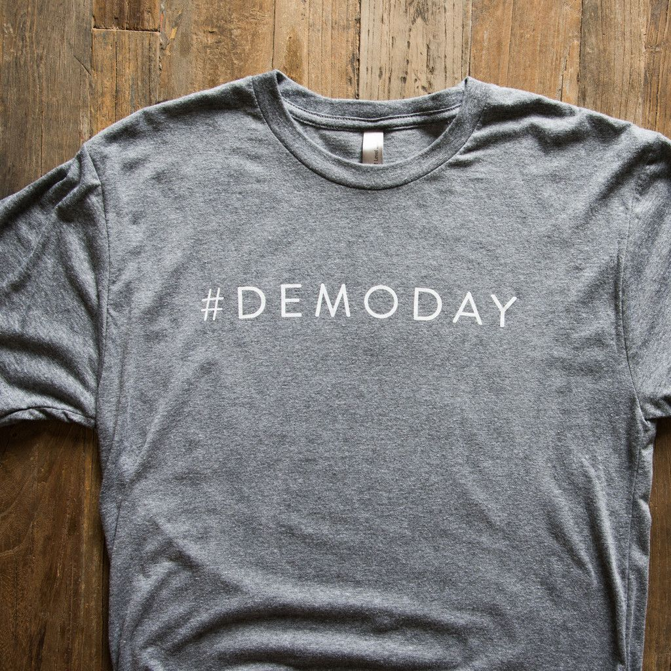
Notes:
Knocking down strongholds!

Slide 55
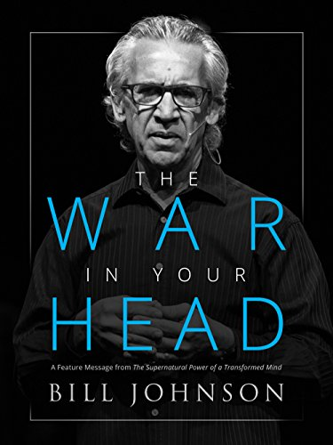
Notes:
Supernatural Power of a Transformed Mind

Slide 56
Be careful how you think;
your life is shaped by your thoughts.
PROVERBS 4:23 (GNT)
Notes:
What are some of the ways of thinking that are not true?
On a personal level, family level, city-wide level, national & international level
God is not real / doesn’t exist
God is not trustworthy
Why do so many bad things happen?
It is what it is…
Whatever… (it doesn’t matter)
Tolerance / no absolutes
It’s not hurting anybody
Born this way / this is just who I am
Our value is in our performance
But also serious bondages to things like pornography
Relational soul ties
Verbal commitments we can’t keep incl. co-signing
Greed
Divorce as covenant breaking
Emotional strongholds

Slide 57
Notes:
Here’s how it works in life
We are moral beings / we have choices to make
But we are fallen and we tend toward NOT doing what’s right
2nd law of thermodynamics
These laws work righteously & unrighteously / both ways

Slide 58
Notes:
Much of our lives will be spent re-learning how to think rightly
Makes you realize the importance of getting the Word of God in you
…transformed (metamorphosis) by the renewing of your mind!!! Romans 12:2

Slide 59
Do not be shaped by this world;
Instead, be changed within
by a new way of thinking.
Then you will be able to decide
what God wants for you;
you will know what is good and pleasing to him
and what is perfect.
ROMANS 12:2 (NCV)

Slide 60
Woe to those who call evil good
and good evil,
who put darkness for light
and light for darkness,
who put bitter for sweet
and sweet for bitter
ISAIAH 5:20 (ESV)

Slide 61
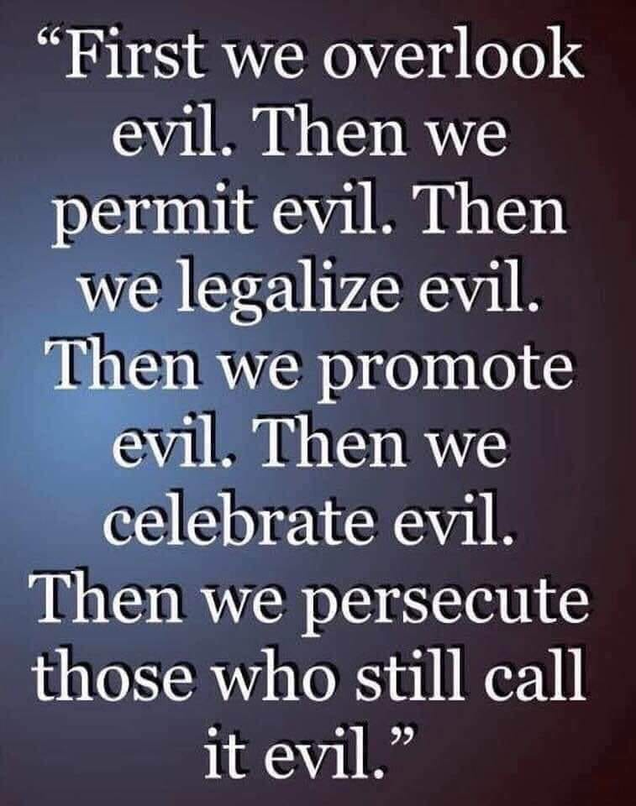

Slide 62
11 Powerful Weapons of Spiritual Warfare
Notes:
11 very powerful weapons to help us in the battle

Slide 63
11 Powerful Weapons of Spiritual Warfare #1 OVERCOME EVIL WITH GOOD

Slide 64
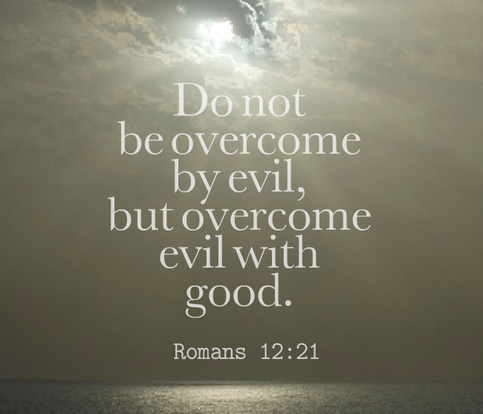
Notes:
notice spiritual warfare terminology: “overcome” ‘ NIKAO
easy to remember: 1 - 2 - 2 – 1
MAJORITY OF S/W IS WAGED IN THE CHOICES WE MAKE IN EVERYDAY LIFE
Every time we choose to say “yes” to the Lord
“responding in the opposite spirit”
this closes doors to the enemy
pride vs. humility
greed vs. generosity
disunity vs. commitment
ex. of radical steps taken by N. Carolina churches
fear vs. faith
rebellion vs. obedience
lust vs. purity
selfishness vs. servanthood
unforgiveness vs. forgiveness
complaining vs. gratefulness
truth vs. lies
it’s not just resisting evil, but taking positive steps of obedience to overcome evil with good
acts of love & righteousness
servant warfare
importance of openness & accountability
transparency

Slide 65
11 Powerful Weapons of Spiritual Warfare #2 PRAYER & INTERCESSION
Notes:
Travail
S/Warfare prayers
Using the imprecatory Psalms

Slide 66
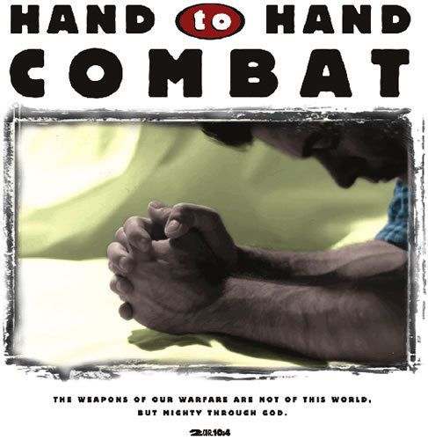

Slide 67
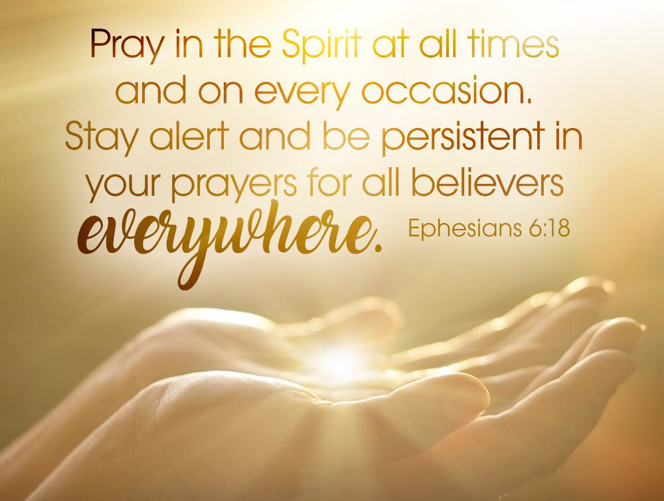

Slide 68
11 Powerful Weapons of Spiritual Warfare #3 FASTING
Notes:
Matthew 6:16: “…when you fast…”
Acts 13:3; 14:23: Important decisions & appointments
Isaiah 58:6-11: God’s kind of fast
extra power / it’s taking God seriously
was an expected part of the disciple’s life
Esther only recorded as fasting, not even praying
Sleep / food / media / Facebook / TV

Slide 69
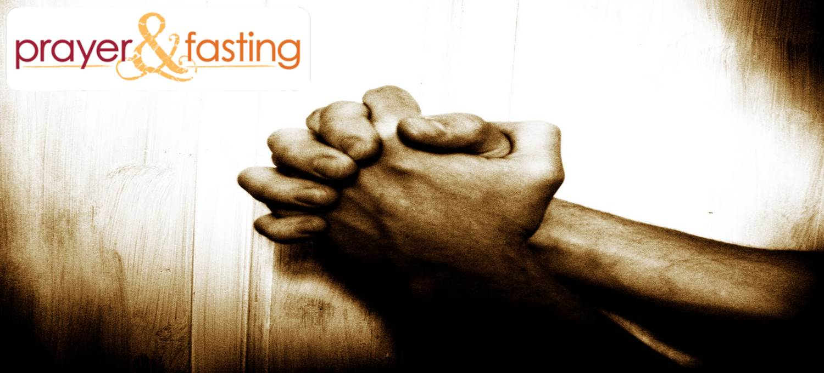
Notes:
VERY common in India: called “fasting-prayer”
Example of SOI ‘99 in Dehradun

Slide 70
MATTHEW 6:16-18

Slide 71
And when you fast, don’t make it obvious, as the hypocrites do, for they try to look miserable and disheveled so people will admire them for their fasting. I tell you the truth, that is the only reward they will ever get. But when you fast, comb your hair and wash your face. Then no one will notice that you are fasting, except your Father, who knows what you do in private. And your Father, who sees everything, will reward you.
Notes:
WHEN YOU FAST!!
Motivation: do it for God & His reward

Slide 72
So, after they had fasted and prayed, they placed their hands on them and sent them off.
ACTS 13:3
Paul and Barnabas appointed elders for them in each church and, with prayer and fasting, committed them
to the Lord, in whom they had put their trust.
ACTS 14:23

Slide 73
ISAIAH 58:6-11
Notes:
Isaiah 58:6–12 (NIV84)
⁶ “Is not this the kind of fasting I have chosen: to loose the chains of injustice and untie the cords of the yoke, to set the oppressed free and break every yoke?
⁷ Is it not to share your food with the hungry and to provide the poor wanderer with shelter— when you see the naked, to clothe him, and not to turn away from your own flesh and blood?
⁸ Then your light will break forth like the dawn, and your healing will quickly appear; then your righteousness will go before you, and the glory of the Lord will be your rear guard.
⁹ Then you will call, and the Lord will answer; you will cry for help, and he will say: Here am I. “If you do away with the yoke of oppression, with the pointing finger and malicious talk,
¹⁰ and if you spend yourselves in behalf of the hungry and satisfy the needs of the oppressed, then your light will rise in the darkness, and your night will become like the noonday.
¹¹ The Lord will guide you always; he will satisfy your needs in a sun-scorched land and will strengthen your frame. You will be like a well-watered garden, like a spring whose waters never fail.
¹² Your people will rebuild the ancient ruins and will raise up the age-old foundations; you will be called Repairer of Broken Walls, Restorer of Streets with Dwellings.

Slide 74
11 Powerful Weapons of Spiritual Warfare #4 BLOOD OF JESUS

Slide 76
They conquered him completely
through the blood of the Lamb…
REVELATION 12:11 (TPT)
Notes:
Blood / what makes it so powerful?
Death / what’s in the blood? (Life)
sacrificial death (blood of the Lamb)
lamb of God
value of what He did
the totally innocent giving His life sacrificially for the totally guilty
this is what gives His blood authority & power
“There's more power in one drop of the shed blood of the Lord Jesus Christ to cleanse men's hearts from the stain of sin,
than the accumulated filth of men's sin since Adam & Eve.”
John Dawson
No man can redeem the life of another or give to God a ransom for him –
the ransom for a life is costly, no payment is ever enough
Psalm 49:7,8
For you know that it was not with perishable things such as silver or gold
that you were redeemed from the empty way of life handed down to you from your forefathers,
but with the precious blood of Christ, a lamb without blemish or defect.
1 Peter 1:18,19

Slide 77
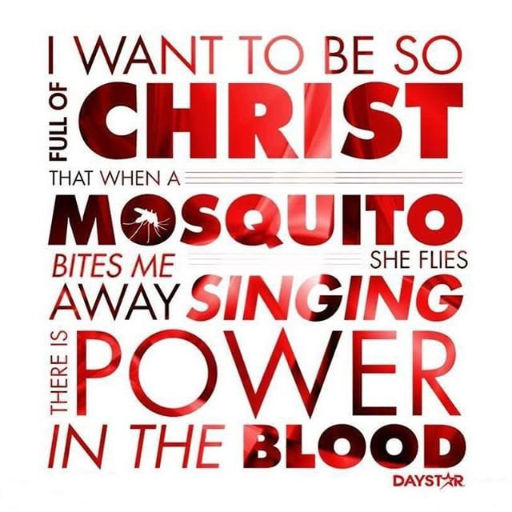

Slide 78
11 Powerful Weapons of Spiritual Warfare #5 OUR TESTIMONY

Slide 79
They conquered him completely through…
the powerful word of his testimony…
REVELATION 12:11 (TPT)

Slide 80
Notes:
nobody can take from you what God has done in your life
It’s the testimony of who Jesus is, what He’s promised (said), and what He has done!
The testimony of Jesus is the spirit of prophecy
Rev 19:10
Sharing your faith teaching in a few weeks

Slide 81
Don’t think your testimony is meaningless
if you didn’t have a dramatic conversion.
Every conversion cost the same amount
of Christ’s blood shed on the cross.
Yours is just as meaningful as the
most dramatic conversion ever told.
BETH MOORE

Slide 82
11 Powerful Weapons of Spiritual Warfare #6 MARTYRDOM
Notes:
once this issue is settled we’re free

Slide 83
…They triumphed because they did not love
and cling to their own lives,
even when faced with death.
REVELATION 12:11 (TPT)

Slide 84
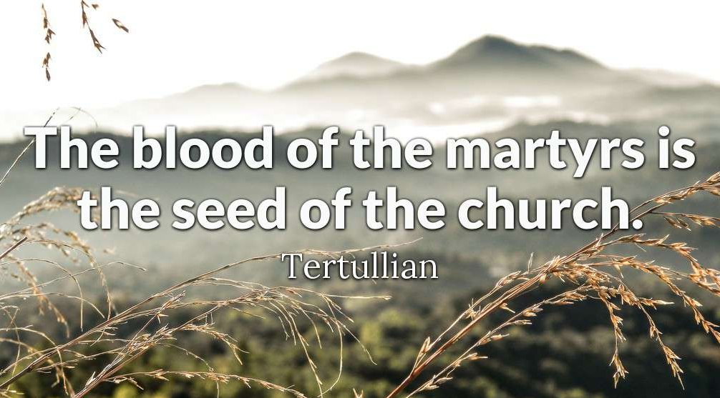
Notes:
TERTULLIAN = full name Quintus Septimius Florens Tertullianus, c. 155 – c. 240 AD, was a prolific early Christian author from Carthage in the Roman province of Africa.
ADD IN HERE THE QUOTE FROM BETH MOORE

Slide 85
More Christians have died for their faith
since the beginning of the 20th century
than all other centuries of
church history combined.
Notes:
The Center for the Study of Global Christianity estimates that
more than 70 million Christians have been martyred
over the last two millennia
.
More than half of these were in the 20th century under
fascist and communist regimes.
For the early 21st century, we estimate that 1 million Christians were
killed over the 10 year period from 2000 – 2010, an average of
approximately 100,000 Christians killed each year or between 287 and 288 martyrs per day: twelve per hour, or one every five minutes!
Photos of ISIS beheading Ethiopian Christians on a beach in Libya / & then publicizing it to the whole world as if bragging

Slide 86
11 Powerful Weapons of Spiritual Warfare #7 THE NAME OF JESUS
Notes:
Mark 16:17: “In My Name they will...”
Luke 10:17: “...Lord, even the demons submit to us in Your Name”
we go/minister as His representatives, ambassadors
The Name of the Lord is a strong tower,
the righteous run into it and are safe.
Proverbs 18:10
it’s understanding Who He is & who we are in relationship to Him
it’s the issue of authority
“all authority” (see Matthew 28:18)
John 17:11 – protected by the power of the Father’s Name (which He gave to Jesus) (read)

Slide 87
Notes:
His Name represents who He is!
His character!
His identity!
His nature!

Slide 88
Notes:
The power in His name comes from the authority that’s been given to Him
“ALL authority has been given to Jesus!

Slide 89
I will remain in the world no longer, but they are still
in the world, and I am coming to You. Holy Father,
protect them by the power of Your name—
the name You gave Me—
so that they may be one as We are one.
My prayer is not that You take them out of the world
but that You protect them from the evil one.
JOHN 17:11,15
Notes:
Jesus’ Name has been given to Him by His Father

Slide 90
11 Powerful Weapons of Spiritual Warfare #8 THE SWORD OF THE SPIRIT
Notes:
Kara’s incredible teaching
So many “amens”
Proclamations & Declarations of truths & promises
Prayers
Songs
* doesn’t have to be in KJV or with a religious voice

Slide 91
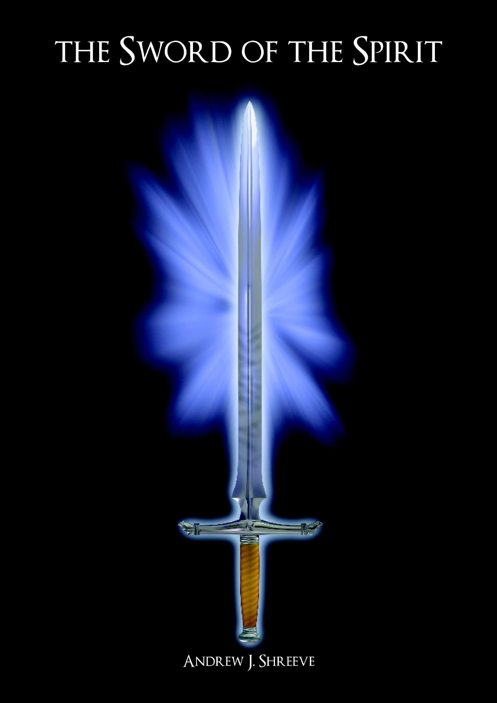
Notes:
Learning accuracy / skill

Slide 92
…and take the mighty, razor-sharp Spirit-sword
of the spoken Word of God.
EPHESIANS 6:17 (TPT)

Slide 93
For we have the living Word of God, which is full of energy, and it pierces more sharply than a two-edged sword. It will even penetrate to the very core of our being where soul and spirit, bone and marrow meet! It interprets and reveals the true thoughts and secret motives of our hearts.
HEBREWS 4:12 (TPT)

Slide 94
…out of his mouth came a sharp
double-edged sword…
REVELATION 1:16
Notes:
When Jesus speaks it’s powerful!

Slide 95
11 Powerful Weapons of Spiritual Warfare #9 PRAISE
Notes:
SOIWSW = School of Worship, Intercession & Spiritual Warfare
Priority of worship
Story of Jehoshaphat in 2 Chronicles 20
Read it?

Slide 96
From the lips of children and infants you have ordained praise because of your enemies,
to silence the foe and the avenger.
PSALM 8:2
Notes:
Why worship is such a powerful part of every time we meet together as the Body of Christ
It’s a slap in the face to the enemy who lost his place as choir director of heaven
See Ezekiel 28:11-19

Slide 97
11 Powerful Weapons of Spiritual Warfare #10 SUBMIT & RESIST

Slide 98
Submit yourselves, then, to God.
Resist the devil, and he will flee from you.
JAMES 4:7
Notes:
Precede by “God opposes the proud but gives grace to the humble
“resist” is same word as used in Eph 6:13 = “antihistamine”
a class of drug that opposes the activity of histamine receptors in the body
* Have Melissa explain

Slide 99
Be self-controlled and alert.
Your enemy, the devil, prowls around like
a roaring lion looking for someone to devour.
Resist him, standing firm in the faith,
because you know that your brothers
throughout the world are undergoing
the same kind of sufferings.
1 PETER 5:8-9
Notes:
“self-controlled” = disciplined
“alert” = clear-minded
Prowls around” = on the hunt
Roaring is also one of their strategies for catching prey –
they creep up on the prey and when they are close enough,
they will let out a roar that confuses that animal(s) and strikes fear into the lion's prey.
The prey then cannot "think" or react correctly out of fear and so is trapped and caught by the lion.
“Aslan” = Mongolian word for “lion”
“devour” = “gulp down”
When a cat is going to drink water, it will stick its tongue out, curl the tip of its tongue backward, not forward.
This curled tip will touch the liquid, barely penetrating the surface, then retract its tongue back into its mouth very, very fast.
The water sticks to its tongue and a mini-stream subsequently shoots up into its mouth thanks to the power of adhesion and cohesion, respectively.
The cat will then close its mouth at exactly the precise moment where the most water will be in its mouth, just before gravity starts to pull it down.
Resist = antihistamine
Stand firm = histamine = a determined stance / not to be moved

Slide 100
11 Powerful Weapons of Spiritual Warfare #11 REBUKE & COMMAND
Notes:
Jesus never prayed about dealing with the demonic
It was always by authoritative command
He knew who He is and where His authority came from and He used it

Slide 101
MATT 8:14-17; MARK 1:29-34
LUKE 4:38-41
Notes:
Follow along in the Mark version of the story
Matt 8:14-17; Mark 1:29-34; Luke 4:38-41
Peter’s mother-in-law
As soon as they left the synagogue, they went with James and John straight to Simon Peter and Andrew’s house. Simon’s mother-in-law was there in bed with a high fever.
When Jesus arrived, the first thing they did was to tell Him about her condition and ask Him to help her. So He walked over and stood beside her bed, and rebuked the fever.
He took her by the hand to help her sit up when the fever instantly left her. At once, she got up off the bed and began to serve them.
Later that evening after sunset and the Sabbath had ended, many others who suffered from all kinds of diseases and those who were tormented by demons were brought to Jesus.
So many came, in fact, that the whole town was gathered together at the door. There also, the demons had to obey Jesus’ simple command, and came out shouting, “You’re the Son of God!”
But He rebuked them and refused to allow them to speak, because they knew that He was the Messiah.
And one by one He laid His hands on those who were sick and healed them all. This fulfilled what the prophet Isaiah spoke:
“He took our illnesses upon Himself and carried away our diseases.”
Isaiah 53:4

Slide 102
As soon as they left the synagogue, they went with James and John straight to Simon Peter and Andrew’s house. Simon’s mother-in-law was there in bed with a high fever. When Jesus arrived, the first thing they did was to tell Him about her condition and ask Him to help her.

Slide 103
So He walked over and stood beside her bed and rebuked the fever. He took her by the hand to help her sit up when the fever instantly left her. At once, she got up off the bed and began to serve them.

Slide 104
Later that evening after sunset and the Sabbath
had ended, many others who suffered from
all kinds of diseases and those who were
tormented by demons were brought to Jesus.
So many came, in fact, that the whole town was
gathered together at the door. There also,
the demons had to obey Jesus’ simple command,
and came out shouting,
“You’re the Son of God!”

Slide 105
But He rebuked them and
refused to allow them to speak,
because they knew that He was the Messiah.
And one by one He laid His hands on
those who were sick and healed them all.
This fulfilled what the prophet Isaiah spoke:
“He took our illnesses upon Himself
and carried away our diseases.”
ISAIAH 53:4

Slide 106
MATT 8:18,23-27; MARK 4:35-41
LUKE 8:22-25
Notes:
Follow along in the Mark version of the story
Matt 8:18,23-27; Mark 4:35-41; Luke 8:22-25
wind & waves
Later that day, as evening came, Jesus noticed the crowds beginning to gather around Him again.
So, He told His disciples, “Come on! Let's sail back over to the other side of the lake.”
So, they left the crowd behind and took Him with them in the boat where He’d earlier been sitting, teaching the people.
And a few other boats accompanied them. As they were crossing the lake, a furious windstorm abruptly arose on the lake,
so fierce that high waves were crashing into the boat, which was nearly swamped.
They were all in severe danger. But Jesus was sound asleep in the bow of the boat with His head on a pillow.
So, the disciples went and woke Him up. “Lord!" they cried out, "save us now! Don't You care that we're about to drown?”
So, He stood up and rebuked the wind and spoke to the raging waves, “Quiet! Be still!”
And the wind died down, and it became completely calm.
“Why are you so afraid?" He asked them. "Don't you have any faith at all?”
But they were absolutely terrified and marveled, and said to one another, “Who is this Man? He just speaks a command and even the wind and the waves obey Him?”

Slide 107
Later that day, as evening came, Jesus
noticed the crowds beginning to gather
around Him again. So, He told His disciples,
“Come on! Let's sail back over
to the other side of the lake.”
So, they left the crowd behind and took Him with them in the boat where He’d earlier been sitting, teaching the people. And a few other boats accompanied them.

Slide 108
As they were crossing the lake,
a furious windstorm abruptly arose on the lake,
so fierce that high waves were crashing into the boat,
which was nearly swamped.
They were all in severe danger.
But Jesus was sound asleep in the bow of the boat
with His head on a pillow.

Slide 109
So, the disciples went and woke Him up.
“Lord!" they cried out, "save us now!
Don't You care that we're about to drown?”
So, He stood up and rebuked the wind
and spoke to the raging waves, “Quiet! Be still!”

Slide 110
And the wind died down,
and it became completely calm.
“Why are you so afraid?" He asked them.
"Don't you have any faith at all?”
But they were absolutely terrified and marveled,
and said to one another, “Who is this Man?
He just speaks a command and
even the wind and the waves obey Him?”

Slide 112
