Slide 1
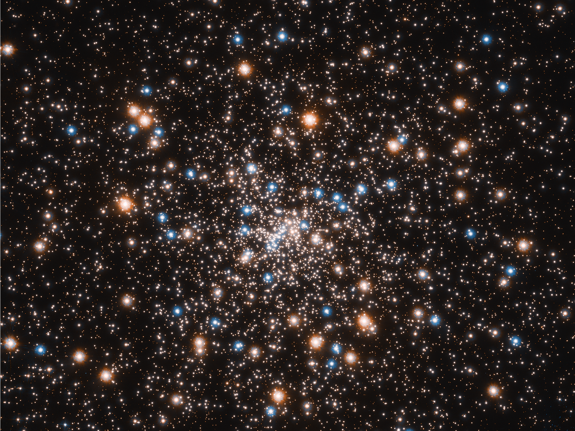
Our God
is
Awesome!!
Notes:
Why is this so important to our daily lives?
How we see God will affect everything in our lives.
We need to experience the reality of who He is / connect with His character & nature & name
You can know and say that God is good
But if you TASTE you will see that God is good (Psalm 34:8)

Slide 2
PSALM 19:1-4a
The heavens declare the glory of God;
the skies proclaim the work of his hands.
Day after day they pour forth speech;
night after night they display knowledge.
There is no speech or language
where their voice is not heard.
Their voice goes out into all the earth,
their words to the ends of the world…
Notes:
David wrote this thousands of years ago without any concept of the Hubble Space Telescope
Probably influenced by what he saw and experienced in his days as a shepherd boy
So much of their lives would have been lived outdoors

Slide 3
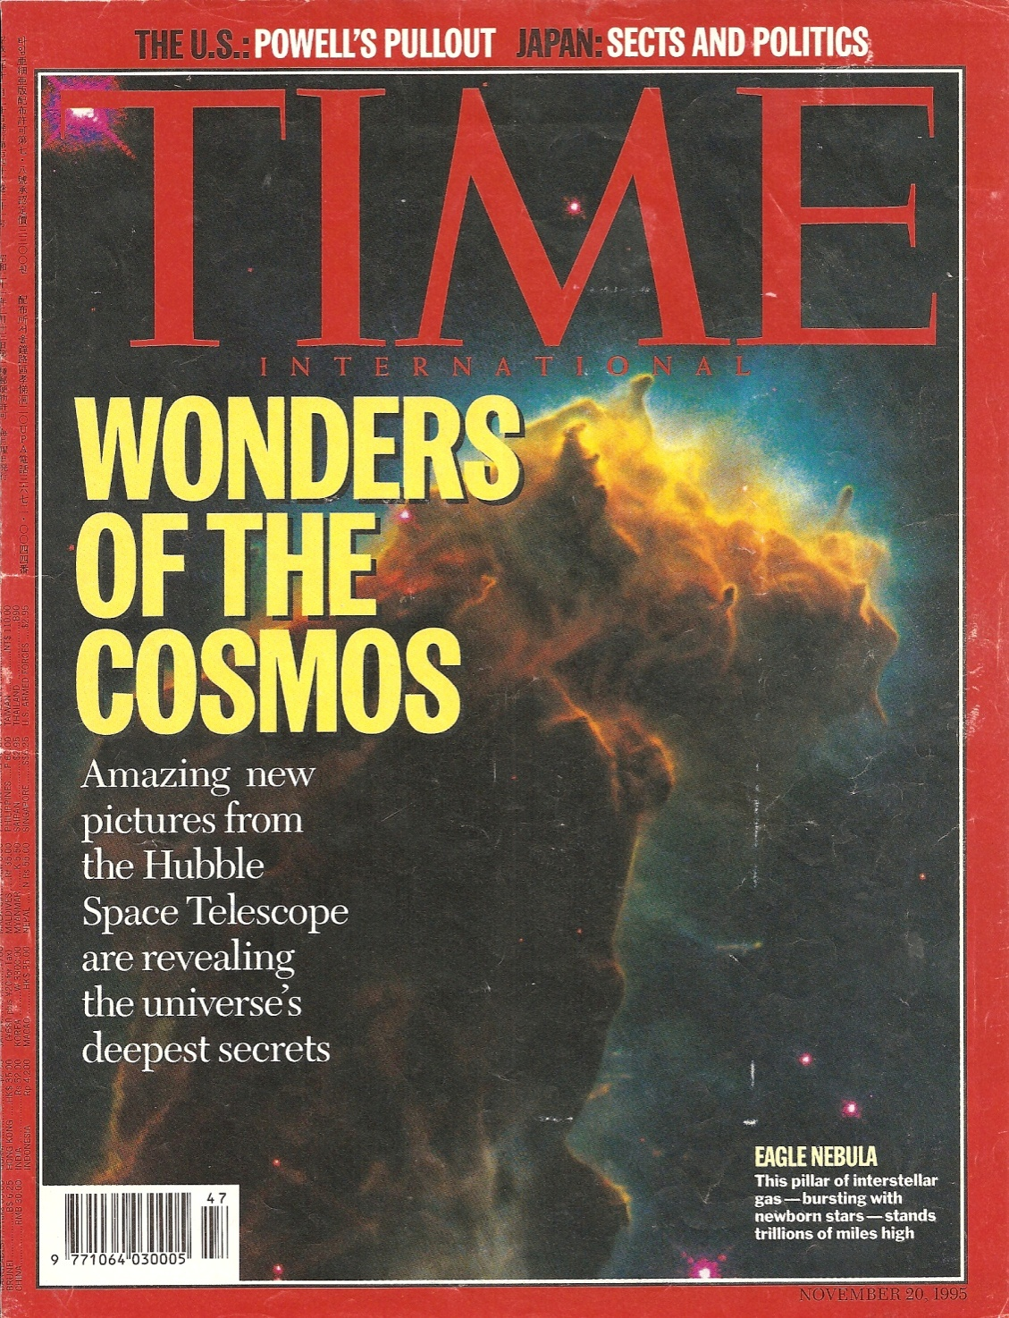
Time International
November 20, 1995
Notes:
I WANT TO TAKE YOU ON A JOURNEY INTO THE HEAVENS THAT DECLARE THE GLORY OF GOD
November 20, 1995
my first intro to the Hubble Space Telescope
Saw this magazine at a newsstand in New Delhi,India

Slide 4
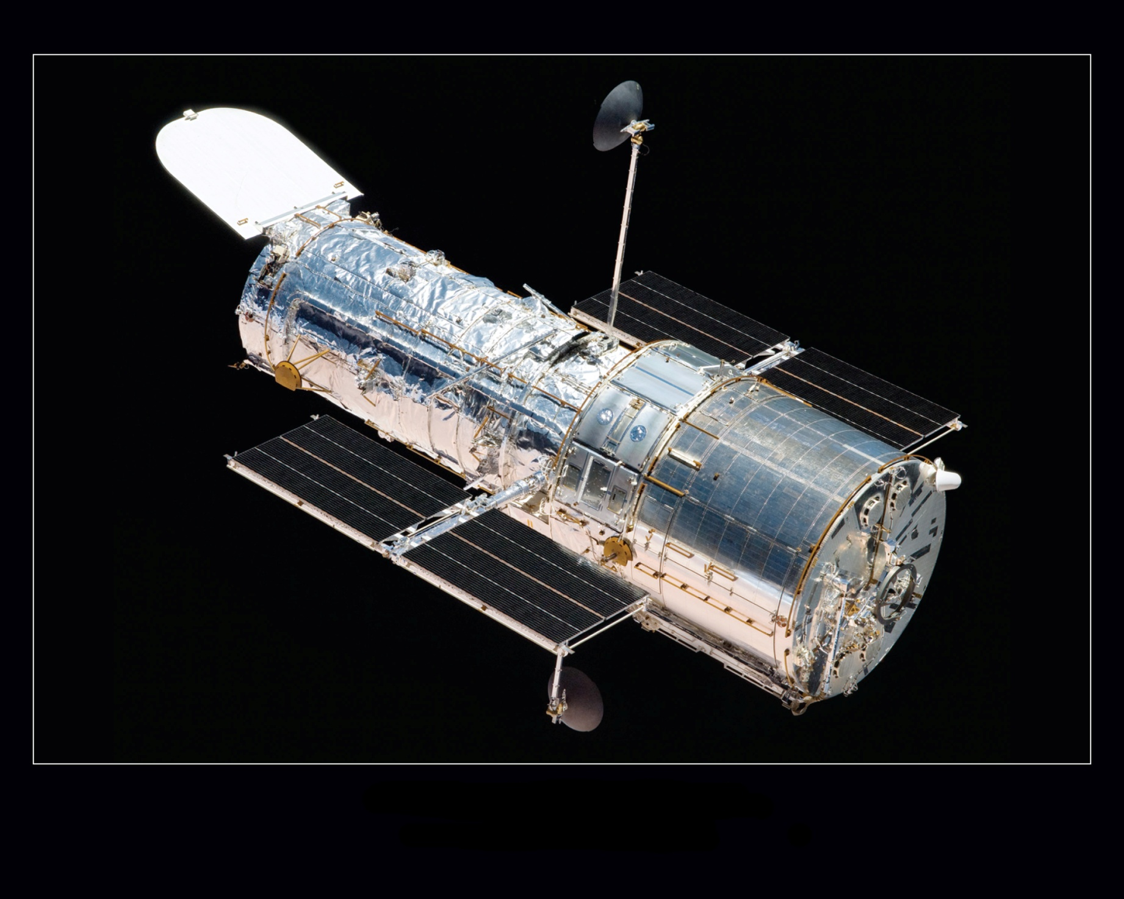
Hubble Space Telescope
Notes:
orbiting observatory at >350 miles above earth
cost $2 billion

Slide 5
Hubble Space Telescope
Notes:
named after an American astronomer, Edwin Hubble
One of the first scientists to recognize that the universe was expanding
12 years in the works with many problems and setbacks (one key lens was ground inaccurately because the technician put one bolt together upside down)
since November ‘93, finally proving of value
Hubble has since sent us millions of exquisite photos of things we never imagined existed before

Slide 6
Earth
Notes:
25,000 miles around (45,000 km): circumference
At the equator, you would weigh less than if standing at one of the poles.
The earth is spinning through space at just over 1,000 miles per hour.
It’s also moving around the sun at 67,000 miles (107,826 km) per hour: orbiting
Earth’s hottest spot goes to El Azizia, Libya, where it hit 136 degrees Fahrenheit in 1922
The coldest place on Earth can be found in Antarctica, but the chill factor is somewhat unbelievable. Winter temperatures there can drop below minus 100 degrees F.
70% covered by water
Goes down to 35,000 feet (Mariana Trench) & houses 50% of all earth’s species of animals / deeper than higher
95 percent of the planet's vast seas have never been seen.
7.7 billion as of today / India grew by the population of the US since 2005 (300 million); they will surpass China in about 4 or 5 years
it had taken all of human history until around 1800 for world population to reach one billion, the 2nd billion was achieved in only 130 years (1930), the 3rd billion in 30 years (1960), the 4th billion in 15 years (1974), and the 5th billion in only 13 years (1987), the 6th billion in another 12 years, the 7th billion in 11 years, and the 8th will take another 11 years (2022 or 2023)

Slide 7
ISS
The Moon
Notes:
ISS in this photo
Distance: 238,856 miles from Earth
Size: The Moon has a diameter of 2,158.8 miles (3,476 km) and is about one-quarter the size of Earth.
Weight: The Earth weighs about 80 times more than Moon
Gravity: things on the Moon will weigh only 16.6% of what they weigh on the Earth
Fun Facts: the moon always shows us the same face. That happens because it takes 27.3 days both to rotate on its axis and to orbit Earth.
the gravitational pull of the moon is also slowing the Earth's rotation, an effect known as tidal braking, which increases the length of our day by 2.3 milliseconds per century.
The energy that Earth loses is picked up by the moon, increasing its distance from the Earth, which means the moon gets farther away by about 4 cm every year.
NASA has a plan to put another person on the moon in 2019-20 & build a space station on the moon with the goal of making it a base for travel to Mars

Slide 8
The Sun
Notes:
It’s a star (not an exceptionally big star)
93 million miles away; 900,000 miles in diameter
100x diameter of earth / 1.3 million earths fit inside
takes 8 minutes 17 seconds for sunlight to reach the earth
it’s flaming ball of gas / energy produced by nuclear fusion in the core of the sun where it’s 27 millionº F / 10,000º F on surface
every second, 700 million tons of hydrogen are converted into helium ashes.
In the process, 5 million tons of energy is released; (as time goes on the sun is becoming lighter)
The Sun’s energy output is 386 billion billion megawatts. The Earth gets 94 billion megawatts of energy from the Sun.
This is similar to 40,000 times the power needed by the US and is the same as the glow of 4 trillion trillion light bulbs of 100 watts. That is a serious amount of energy.
it would take 10 million years of the GNP (the market value of all goods and services produced in one year by labor and property supplied by the residents of a country) of Kenya to enable the Mombasa Diesel Generating Power Station to power the sun for 1 second
In Norway at a certain time of the year the Sun shines all day and all night for three and a half months. How would you get any sleep?
As big as it is, the sun is a relatively small star

Slide 9
Notes:
There are 7 bigger stars they’ve discovered since this video was made, with the 2nd biggest, “Scuti” being 20% bigger than Cannes Majoris & 2x as big as Betelgeuse & 1,700x bigger than our sun
The biggest known star is Quasi Star (Black-Hole Star) which is 5x bigger than Scuti, 10x bigger than Betelguese, and 8,500x bigger than our sun (star)

Slide 10
Notes:
Cannes Majoris = “Big Dog”
1400 x bigger than our sun
It would take an Airbus A380 1,100 years to circumnavigate this star one time

Slide 11
Betelgeuse
Notes:
One of the bigger stars
1000x bigger than our sun

Slide 13
Betelgeuse
600 light years away!
Notes:
This star is 600 light years away
still in our neighborhood!
Distances are so great we have to use a different means of measuring: the light year

Slide 14
So, what is a LIGHT YEAR?
It’s the distance light travels in 1 year
Notes:
the distance light travels in 1 year

Slide 15
How fast does light travel?
about 186,000 miles/second
or about 671 million mph
or
1 footstep every one billionth of a second
Notes:
light travels at the speed of 186,282,397 miles/sec or 299,792.458 km/sec

Slide 16
How fast is that?
Notes:
shoot a bullet at the speed of light from Mt. Everest (>29,000 feet) & it will go around the earth 7.5x & hit you in the back before you can duck to avoid getting hit

Slide 17
So, how far does light travel
in one year?
about 5,850,000,000,000 miles
or
about 6 trillion miles
Notes:
about 10,000,000,000,000 kms/year (10 trillion) = 1 light year
6 with 12 zeros following miles

Slide 18
Betelgeuse
600 light years away
Notes:
that’s 3.5 followed by 15 zeros (million-billion)

Slide 19
THIS IS OUR NEIGHBORHOOD!
OUR SOLAR SYSTEM
The Milky Way Galaxy
100,000 light years across
or about 600 million-billion miles
Notes:
Here’s where we live!
600 followed by 15 zeros
our Sun orbits the center of the Milky Way galaxy at a distance of about 25,000 light-years from the galactic center (about 150 million-billion miles), completing one revolution in about 225–250 million years.
It travels at a speed of 12 miles per second / that’s about 45,000 kilometers per hour.

Slide 20
The Milky Way Galaxy
200 – 400 Billion Stars
Notes:
200 – 400 billion stars (of which our sun is but one)
to count this number of stars at 1/second, it would take you 2,500 years
separated by billions of miles

Slide 21
The Pleiades
Notes:
called the Seven Sisters
found 3x in the Bible: Job 9:9; 38:31; Amos 5:8
440 light years away in the Milky Way
4.4 million-billion kms (2,640 million-million miles)

Slide 22
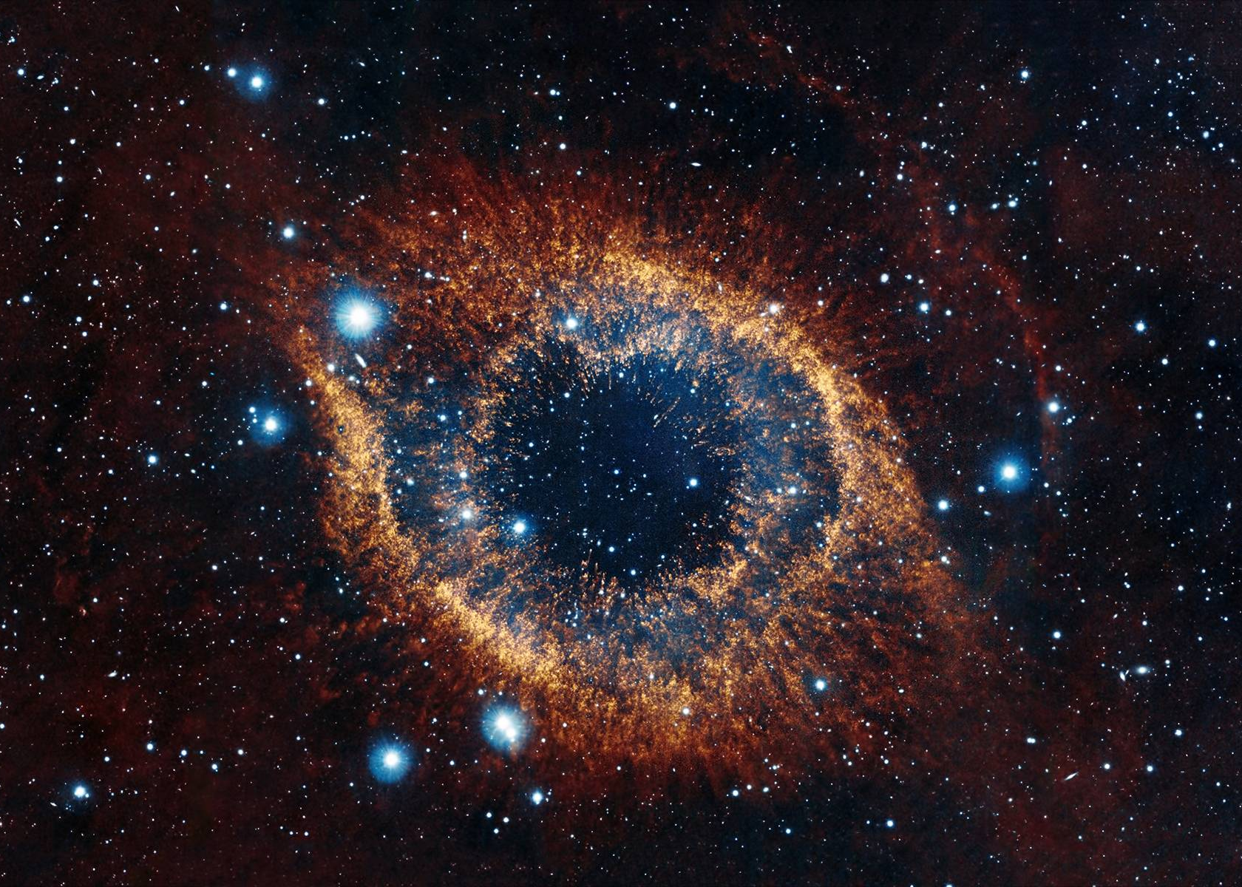
“Eye of God” Nebula
Notes:
nebulas = clouds of dust, hydrogen & helium from dying stars
650 light years away (almost same as Betelgeuse)
6.5 million-billion kms (4 million-billion miles)

Slide 23
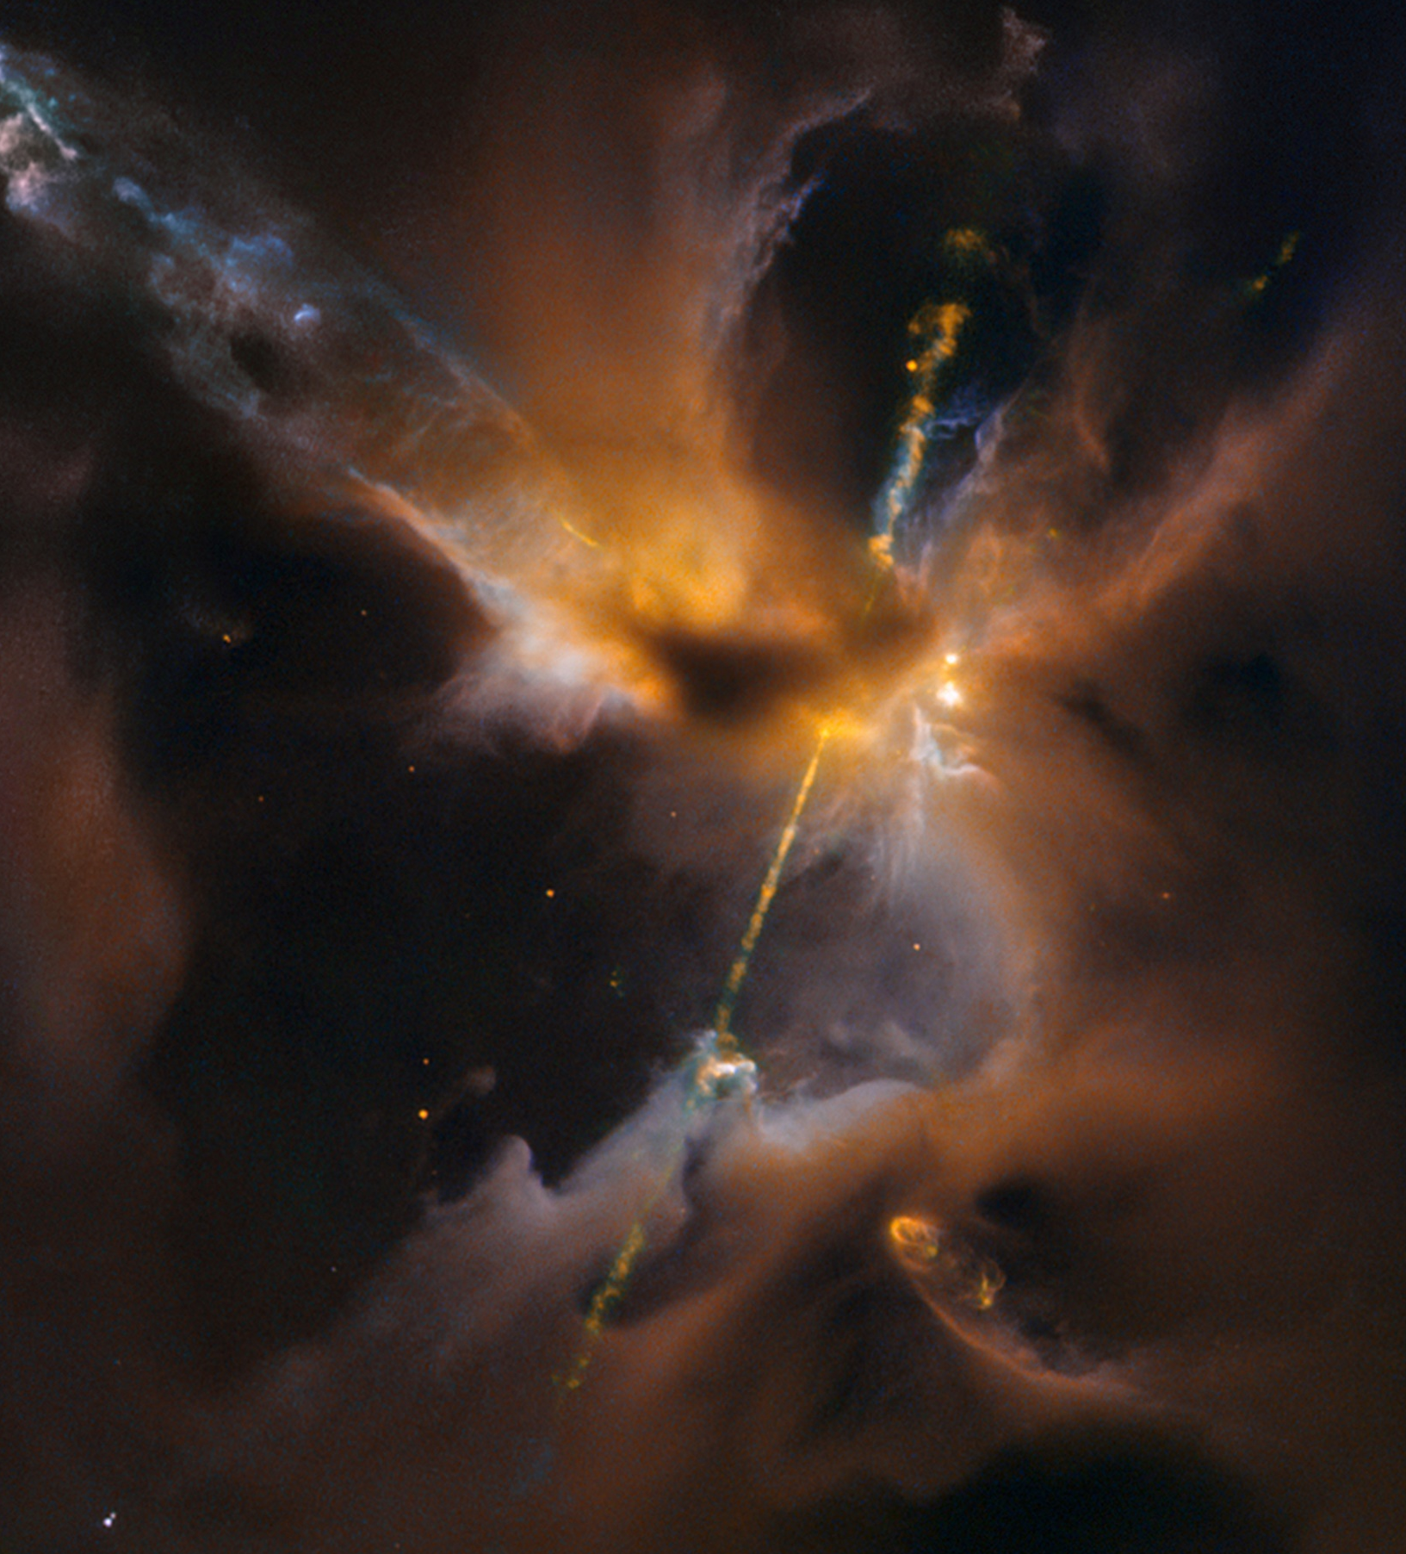
Herbig Haro Jet
Notes:
Herbig Haro Jet
1,350 light years away (still in our galaxy)
100 million-billion kms
Birth of new star

Slide 24
Veil Nebula
Notes:
1,470 light years away (still in our galaxy)
100 million-billion kms
Explosion of a star 20x bigger than our sun

Slide 25
Horsehead Nebula
Notes:
1,500 light years away
15 million-billion kms (9 million-billion miles away)

Slide 26
Cat’s Eye Nebula
Notes:
3000 light years away
30 million-billion kms
or, 18 million-billion miles

Slide 27
Eagle Nebula
Notes:
7000 light years away
70 million-billion kms
Or, 400 million x as far away as our sun

Slide 28
Eagle Nebula
Notes:
hydrogen gas pillar is 10 trillion kms high
stars being birthed out of the death of some older stars
these nubs are bigger than our solar system

Slide 29
Hourglass Nebula
Notes:
8000 light years away (still in our galaxy)
80 million-billion kms

Slide 30
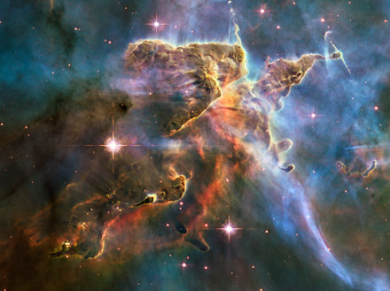
Carina Nebula
Notes:
10,000 light years away (still in our galaxy)
100 million-billion kms (60 million-billion miles)

Slide 31
“Hand of God” Neutron Star
Notes:
17,000 light years away (still in our neighborhood)
170 million-billion kms (102 million-billion miles)
A neutron star is the densest known object in the universe, with a mass twice that of our sun packed into a sphere about 12 kms across
Related to pulsars
A teaspoon could weigh millions or billions of tons (billions of kgs)
Formed when stars die and explode, the power released causing them to spin at 3,000 x/second
Gravity pulls the matter in and fuses the electrons & protons together which form neutrons

Slide 32
Tarantula Nebula
160,000 light years away
Notes:
160,000 light years away (still in our galaxy)
96 billion-billion miles (15 zeros)

Slide 33
Sombrero Galaxy
28 million light years away
(contains about 700 billion stars)
Notes:
28 million light years away
280 billion-billion kms
has 700 billion suns (100x more than people on earth!)
50,000 light years across (half the distance of the Milky Way)

Slide 34
Whirlpool Galaxy
31 million light years away
Notes:
31 million light years away
310 billion-billion kms
60,000 light years across
160 billion stars

Slide 35
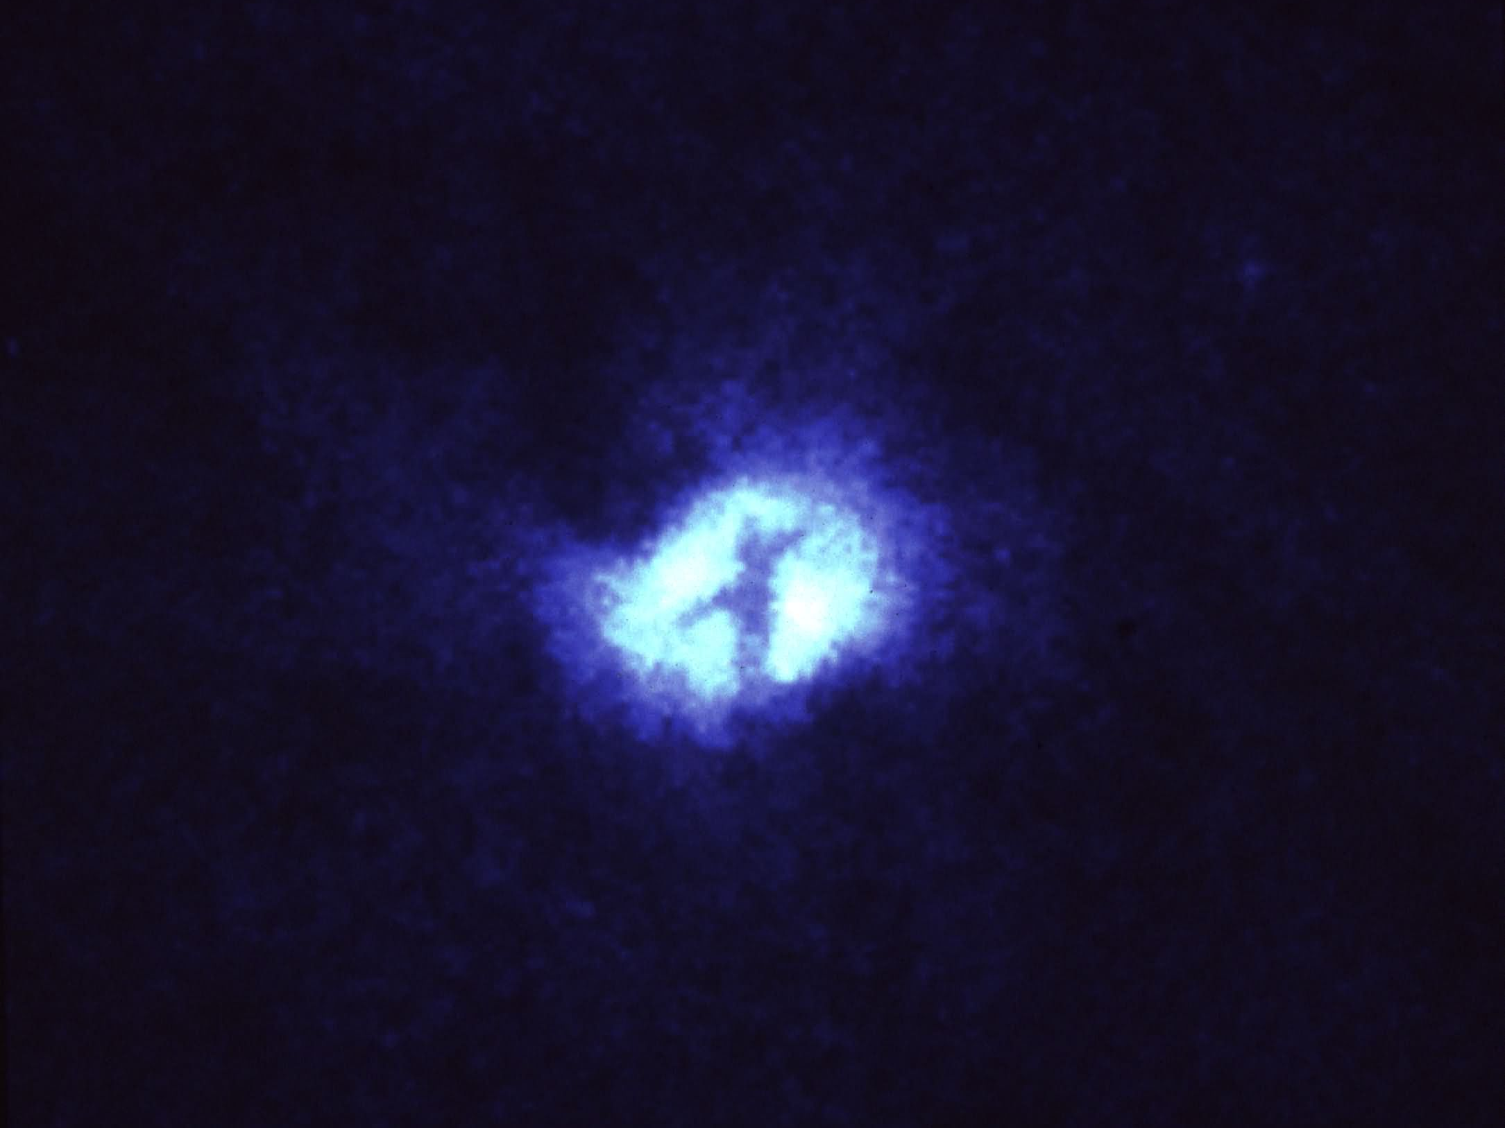
“Cross Factor”
in the Whirlpool Galaxy
Notes:
100 light years across
600 million-million kms
Marks the exact position of the center of a black hole with a mass equivalent to 1 million of our suns
Matthew 24:30 talks about “a sign announcing the Son of Man will appear in the heavens”

Slide 36
So, how big
is the known universe?

Slide 37
Galaxies photographed
13 billion light years away
Notes:
in July of 1997 Hubble sent images of galaxies 13 billion light years away

Slide 38
How far away is
13 billion light years?
Notes:
What does 13 billion light years mean?
Remember, we said light travels at about the speed of 300,000 kms/sec or 10 trillion kms/year (186,000 miles/sec or 6 trillion miles/year)
If you multiply 6 trillion miles x 13 billion you’ll find that these newly photographed galaxies are >78 trillion-billion miles away (78 + 21 zeros)
HOW FAR IS THAT?
Jefferson City to Knoxville is about 30 miles
Jefferson City to Jinja, Uganda is about 7,700 miles
Distance to the sun is about 93 million miles
The next nearest neighboring star, Alpha Centauri, is about 25 billion miles away
ANYONE BORN IN JEFFERSON CITY?
If you started out running the day you were born in Jefferson City & ran a mile every 5 minutes (12 mph) / 24-7, you would be about 43 days old by the time you reached Jinja!
You would be about 1,500 years old before you reached our sun
You would be over 380,000 years old when you reached Alpha Centauri.
By the time you reached one of these galaxies you’d be about 1 (with 18 zeros) years old!!
that’s 1 billion-billion years old!!!

Slide 39
So, how big
is the known universe?
150 billion light years across!!
or
1.5 trillion-trillion kms!!
Notes:
The known universe is about 150 billion light years across
(or nearly 1+24 zeros or 1 trillion-trillion kms!!!!)

Slide 40
So, how many stars are there in the universe?

Slide 41
100s of Billions
of Galaxies
Notes:
they used to say there were about 10 billion galaxies
but now Hubble has forced them to say there are at least 200 billion galaxies of incredible variety & beauty & size

Slide 42
10s of Billions
of Stars in Each Galaxy
(sometimes 100s of billions)
Notes:
many of these have 100s of billions stars, many separated by trillions of miles
Sir James Jean, one of the 20th centuries most brilliant astronomers, said there are more stars in the universe than grains of sand on all the seashores of earth

Slide 43
Notes:
Newspaper stuck under the door of our room at the YWCA Guest House in New Delhi, India on our way back from the U.S. to India in 2003!
70 sextillion or 70 thousand, million, million, million
tell about my rough measurement of all the sea coasts
what about the rest of the physical universe we don’t know about yet? Dark matter?

Slide 44
James Webb Space Telescope
Notes:
and this is all our technology shows us thus far (how much more is out there?)
there’s a more powerful, follow-up telescope called the James Webb Telescope
March 30, 2021 launch date
6x bigger mirror for the camera
It will cost about $10 billion
It’s orbit will be beyond the moon
What will it show us?? What will we see?

Slide 45
ISAIAH 40:25-26
Good News Bible
To whom can the Holy God be compared?
Is there anyone else like Him?
Look up at the sky!
Who created the stars you see?
The One who leads them out like an army,
He knows how many there are
and calls each one by name!
His power is so great—
not one of them is ever missing!

Slide 46
JOHN 1:1-3
In the beginning the Word already existed.
The Word was face-to-face with God,
and the Word was Himself fully God.
He was there in the beginning with God.
He created everything there is,
and not one thing exists apart from Him.
Notes:
Word = Logos

Slide 47
COLOSSIANS 1:15-17
New Living Translation
Christ is the visible image of the invisible God.
He existed before anything was created
and is supreme over all creation.
For through Him God created everything
in the heavenly realms and on earth.
Notes:
Paul’s description of John 1:1-3

Slide 48
He made the things we can see
and the things we can’t see—
such as thrones, kingdoms, rulers,
and authorities in the unseen world.
Everything was created through Him and for Him.
He existed before anything else,
and He holds all creation together.

Slide 49
2 PETER 3:10
But the day of the Lord will come like a thief.
The heavens will disappear with a roar;
the elements will be destroyed by fire,
and the earth and everything in it
will be laid bare…

Slide 50
2 PETER 3:12-13
…That day will bring about
the destruction of the heavens by fire,
and the elements will melt in the heat.
But in keeping with his promise we are looking forward to a new heaven and a new earth,
the home of righteousness.

Slide 51
PSALM 8:3-4
When I consider your heavens, the work of your fingers, the moon and the stars, which you have set in place, what is man that you are mindful of him, the son of man that you care for him?

Slide 52
PSALM 139:17
A Poem of Praise by King David
Passion Translation
Every single moment you are thinking of me! How precious and wonderful to consider that you cherish me constantly in your every thought!
O God, your desires toward me are more than the grains of sand on every shore! When I awake each morning, you’re still with me.

Slide 53
JEREMIAH 32:17
English Standard Version
Ah, Lord God!
It is you who have made the heavens
and the earth by your great power
and by your outstretched arm!
Nothing is too hard for you.

Slide 54
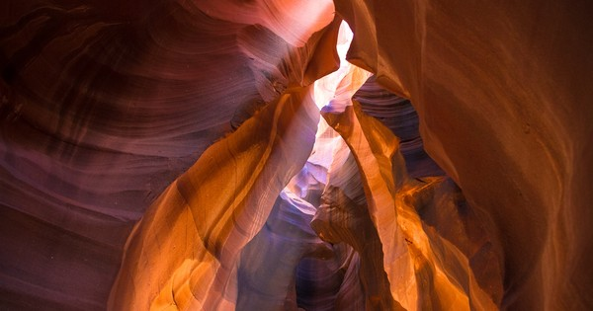
There are more atoms in one grain of sand than there are stars in the entire known universe!
Notes:
Sand = SiO2 = silicon dioxide
HAND OUT BAGS OF SAND

Slide 55
Notes:
The question of the ages

